Slide 1
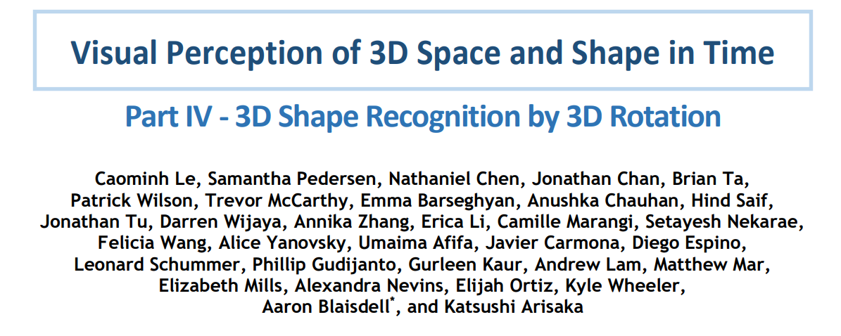

Slide 2

About My Research Group

Slide 3
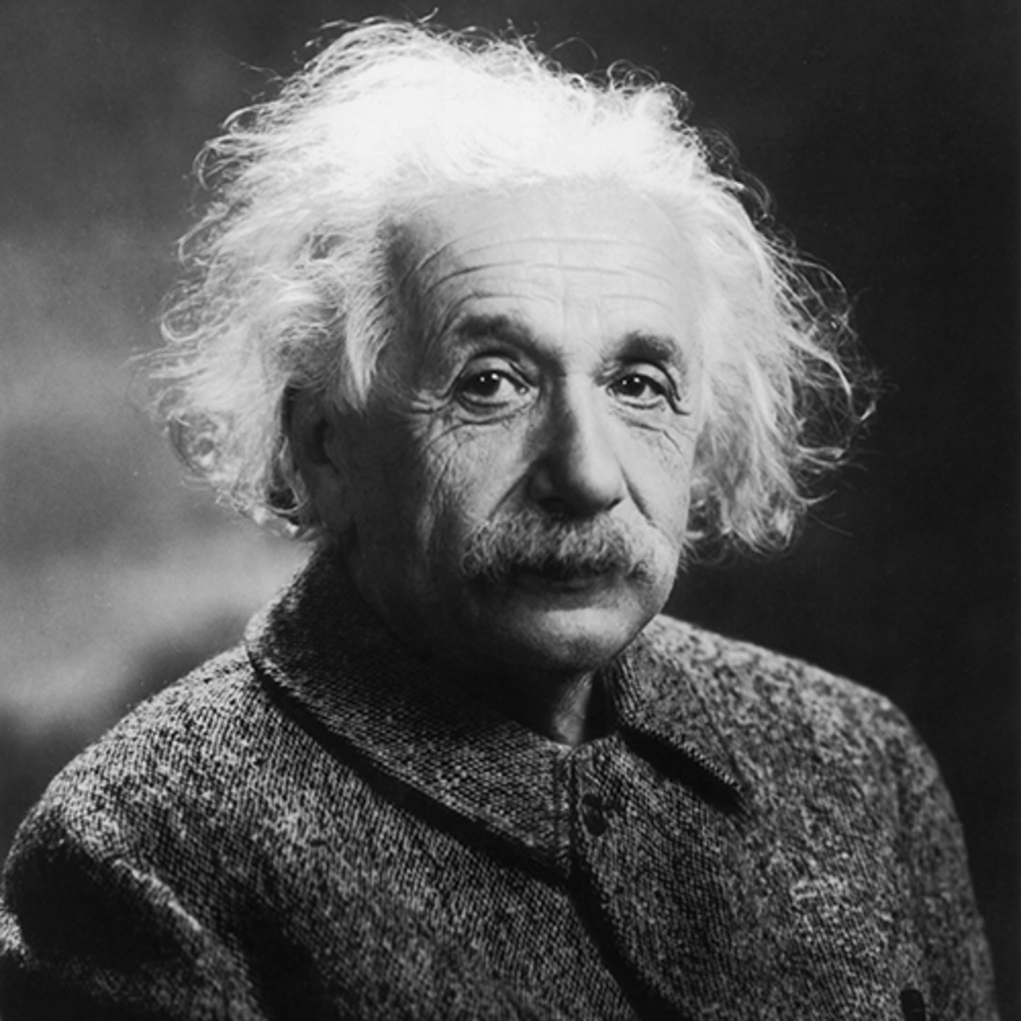
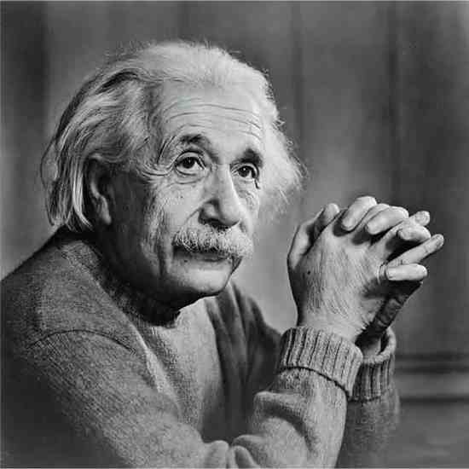
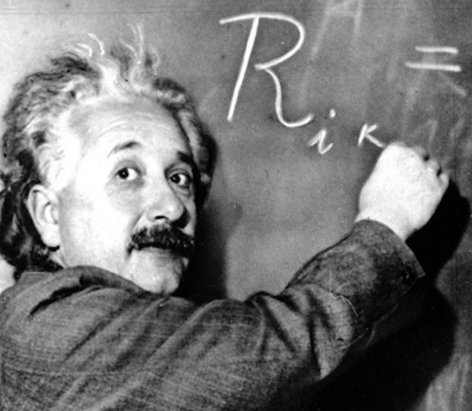
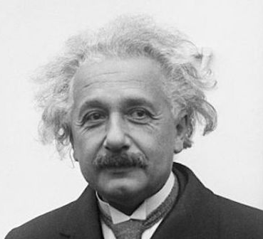
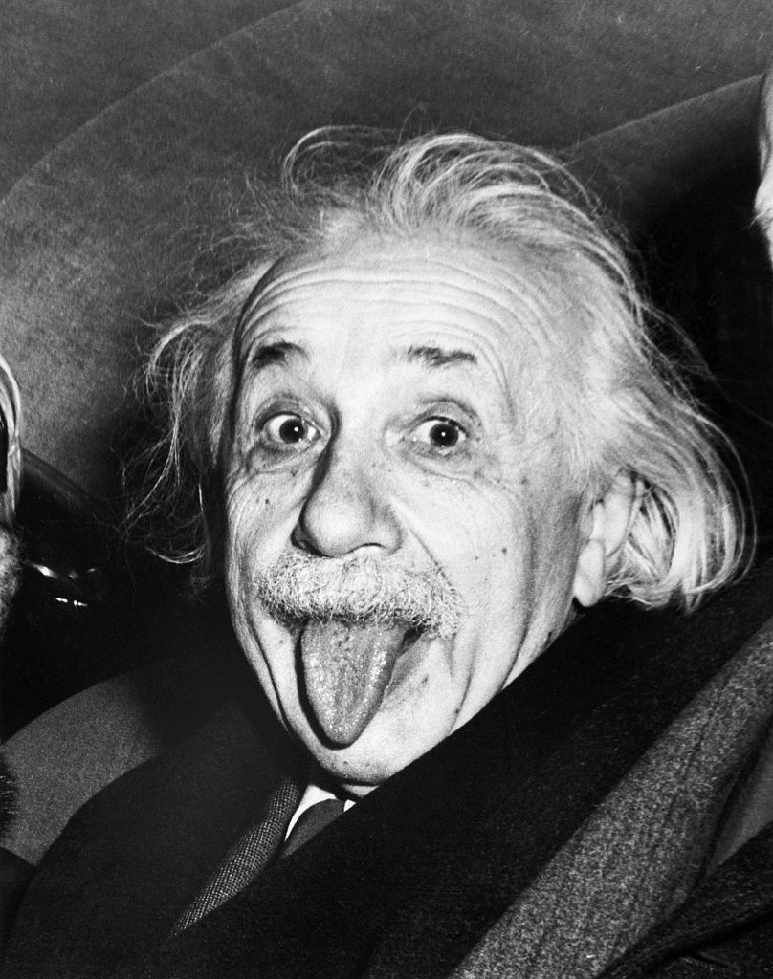
Facial Recognition

Slide 4
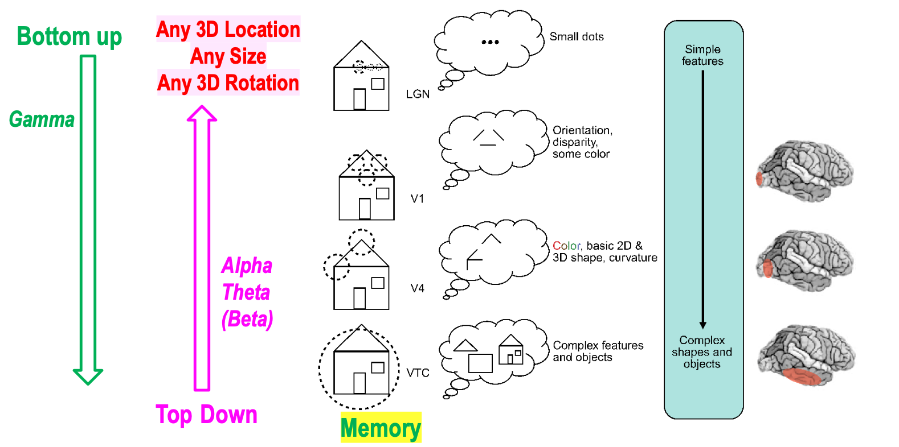
Complex Image
Top Down
Bottom Up
Small Details

Slide 5
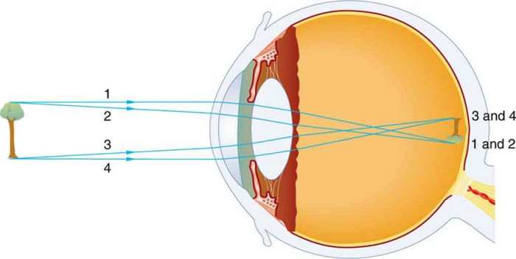
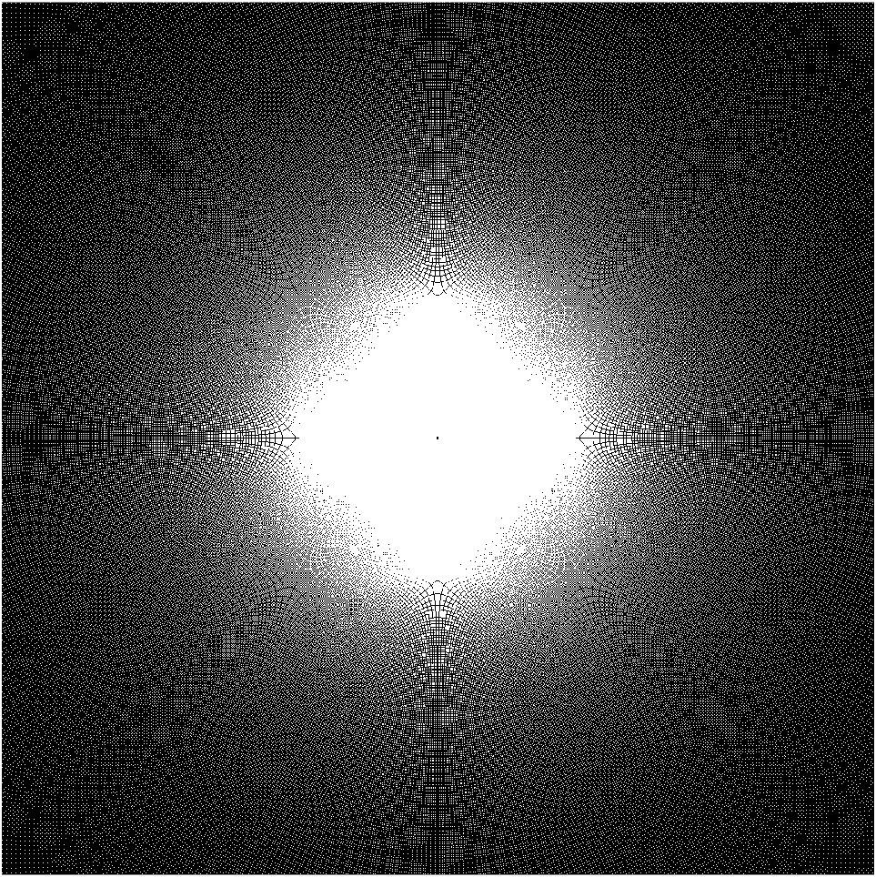

Distortion of Visual Input

Slide 6
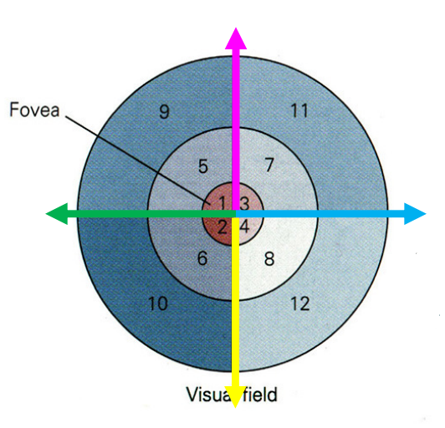
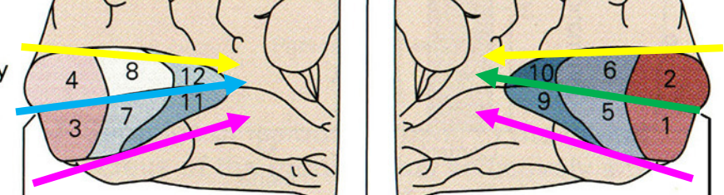

Distortion of Visual Input
Environment Retina Visual Cortex

Slide 7
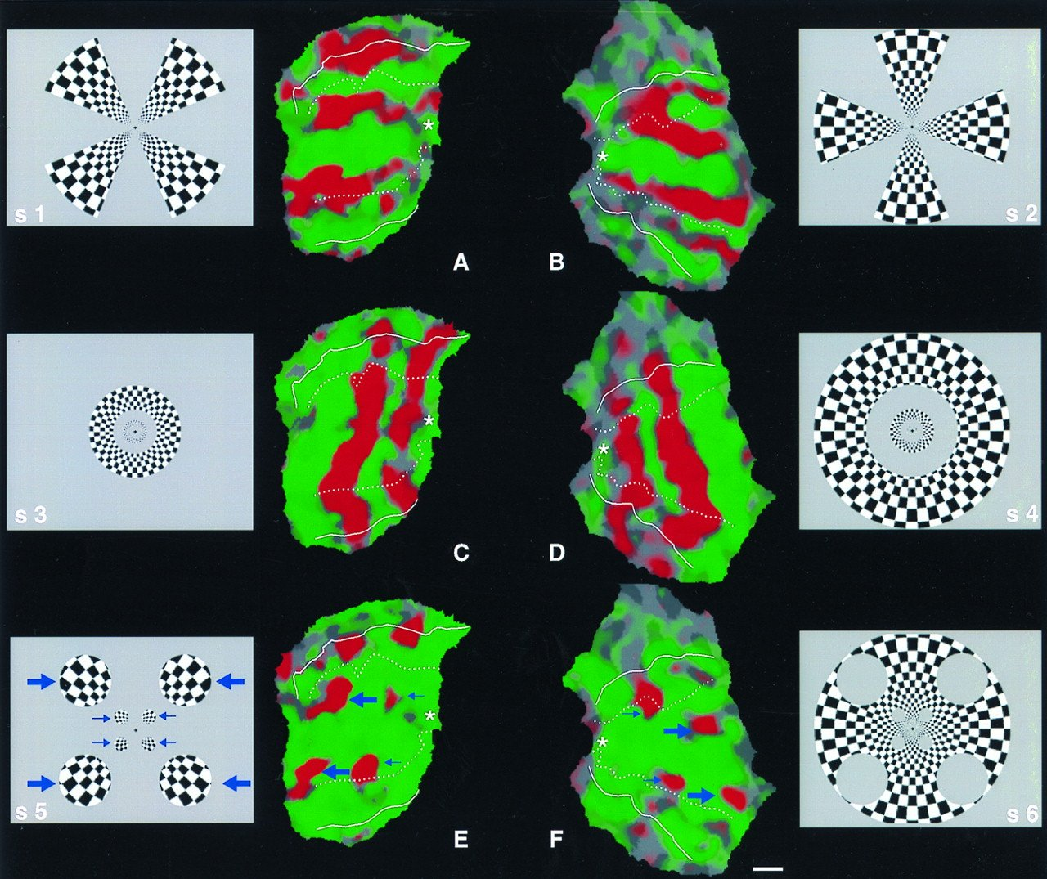
y
Log Polar Mapping
3
r = 5
Cartesian Coordinates
Log-Polar Coordinates
x
4
θ = 53°
θ
53°
r
Log(5)
Notes:
https://www.pnas.org/doi/10.1073/pnas.95.3.811

Slide 8
Cartesian and Log-Polar grids
Up
UP
Right
Left
Down
Right
2°
4°
Left
Down
8°
Up
0.25° 0.5° 1° 2° 4° 8°

Slide 9
Log Polar Mapping
-270
-180
-90
0
90
Right Cortex
Left Cortex
Align Polar Axes
Fovea ➔ Periphery
Log(distance)

Slide 10
Scaling is encoded by a Horizontal Shift

Slide 11
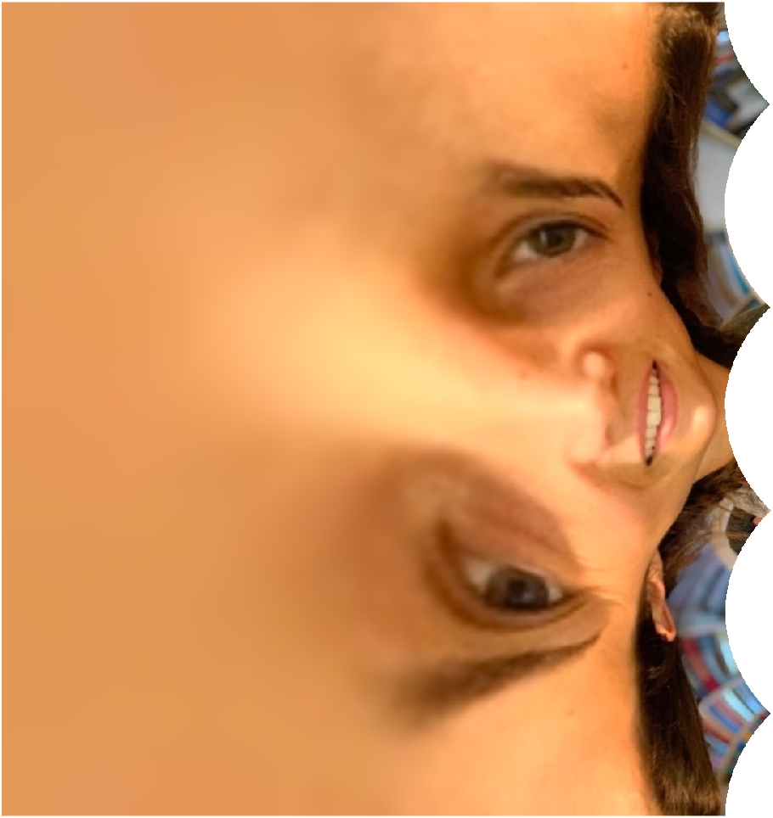
Memorized Face

Slide 12
Double Sized Face

Slide 13
Half Sized Face

Slide 14
Rotation is encoded by a Vertical Shift

Slide 15
Memorized Face

Slide 16
45 degrees counterclockwise

Slide 17
90 degrees Clockwise

Slide 18
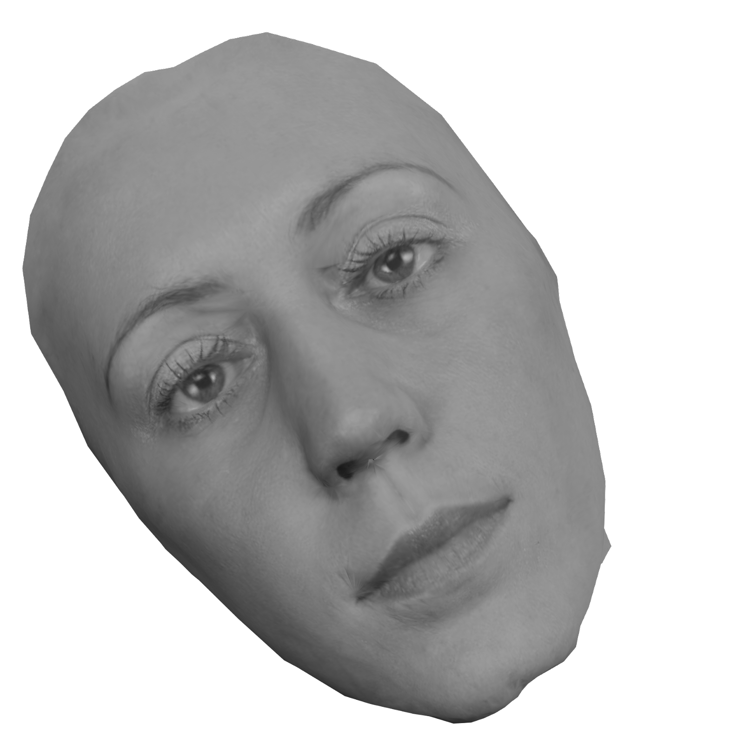
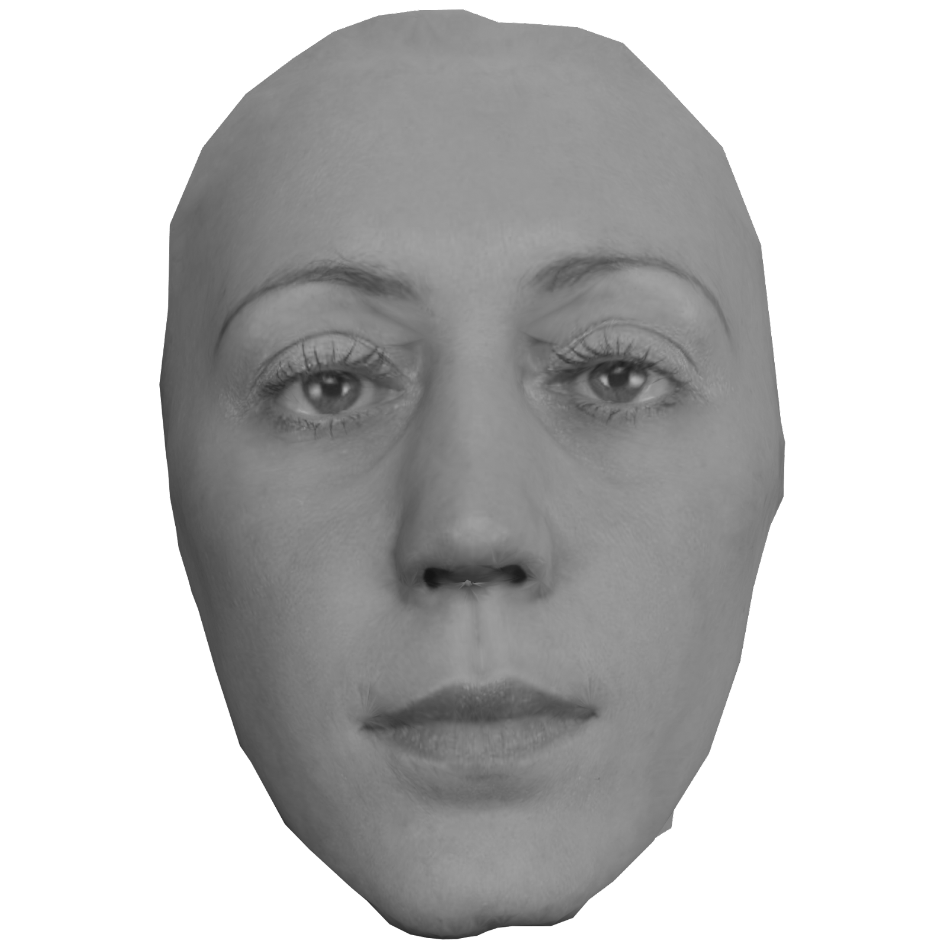
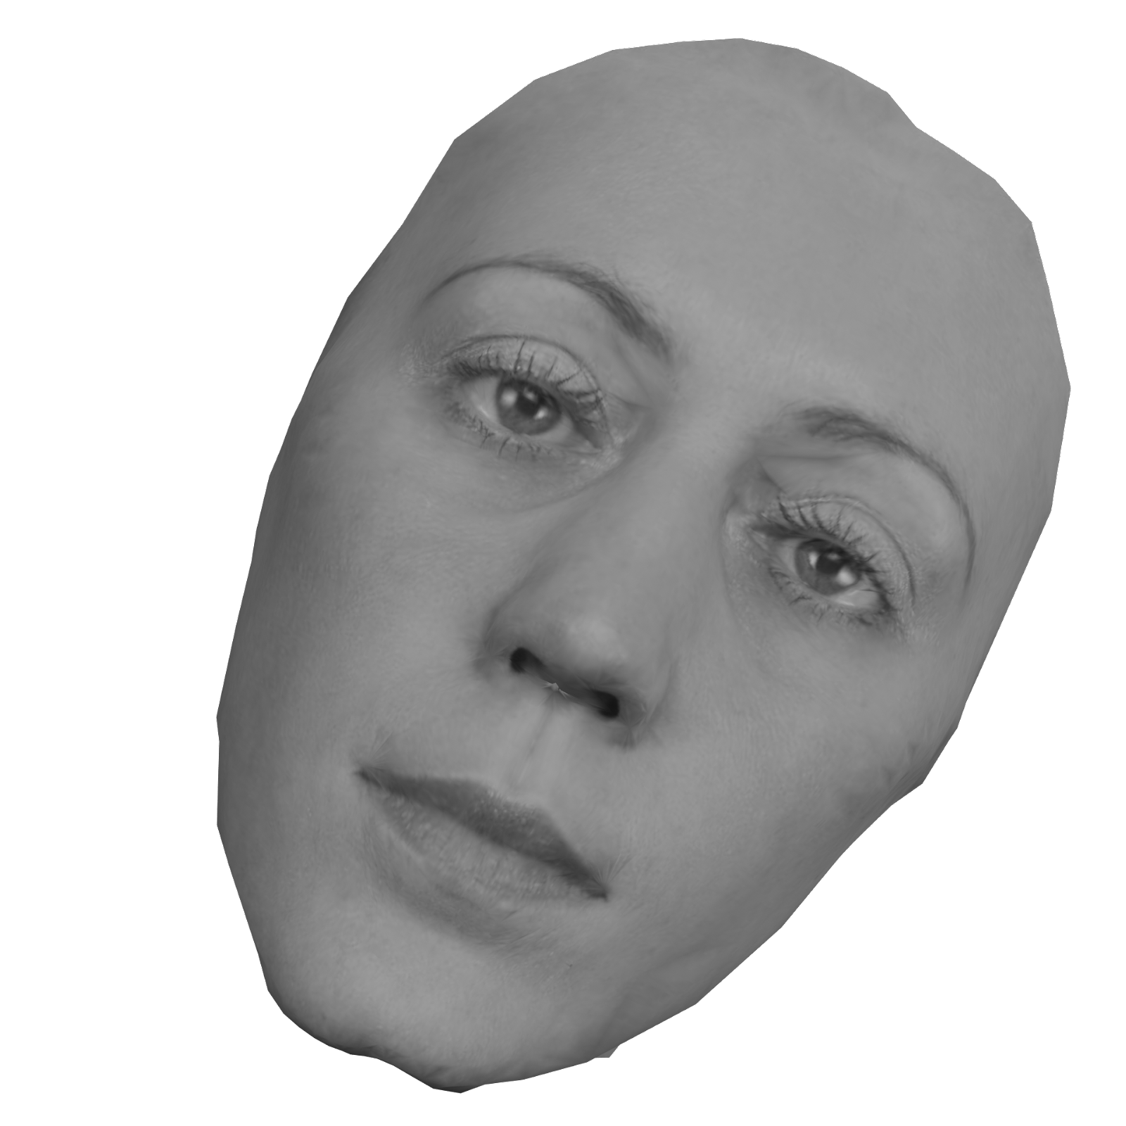
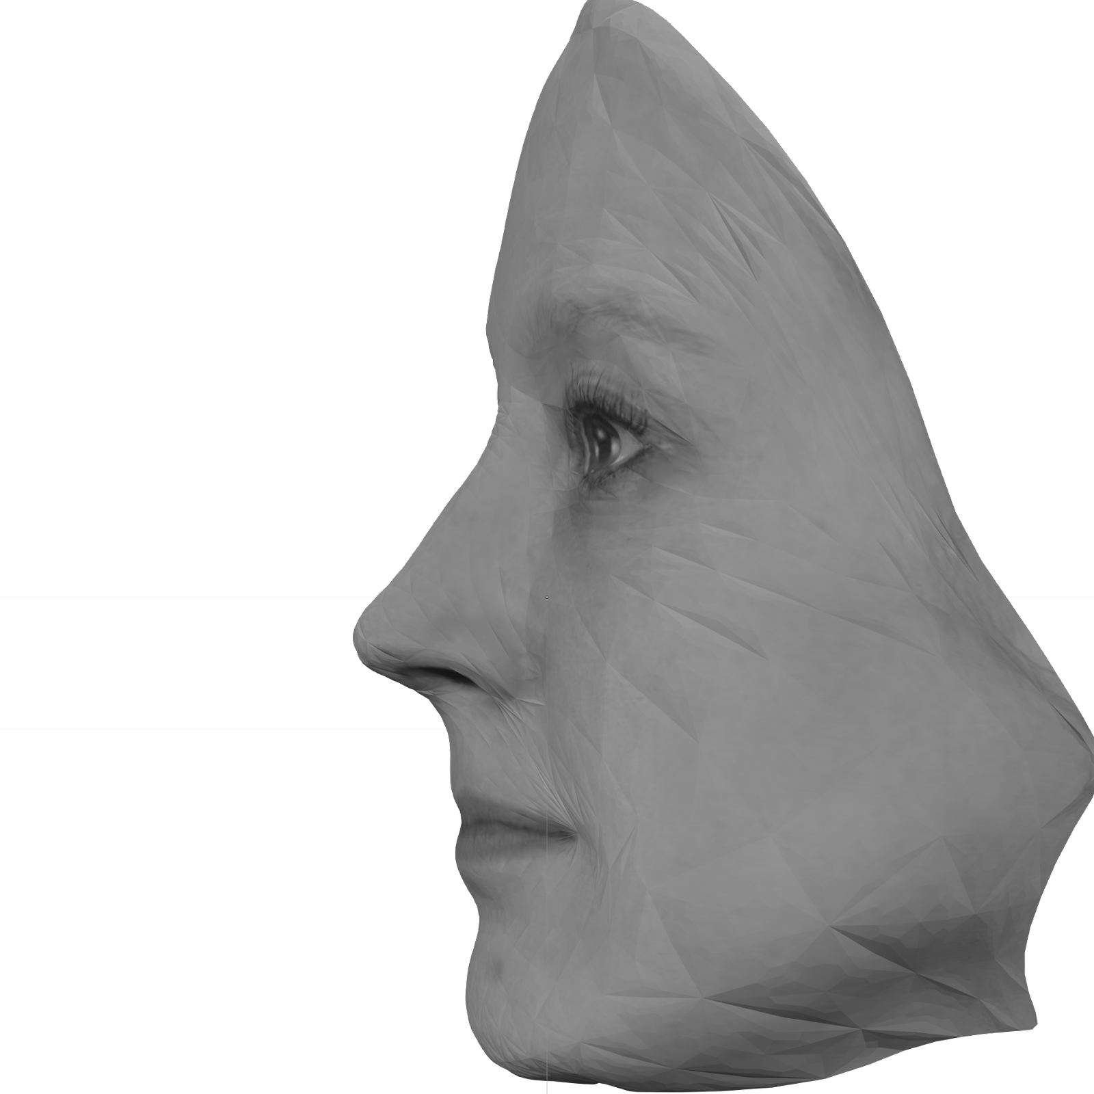
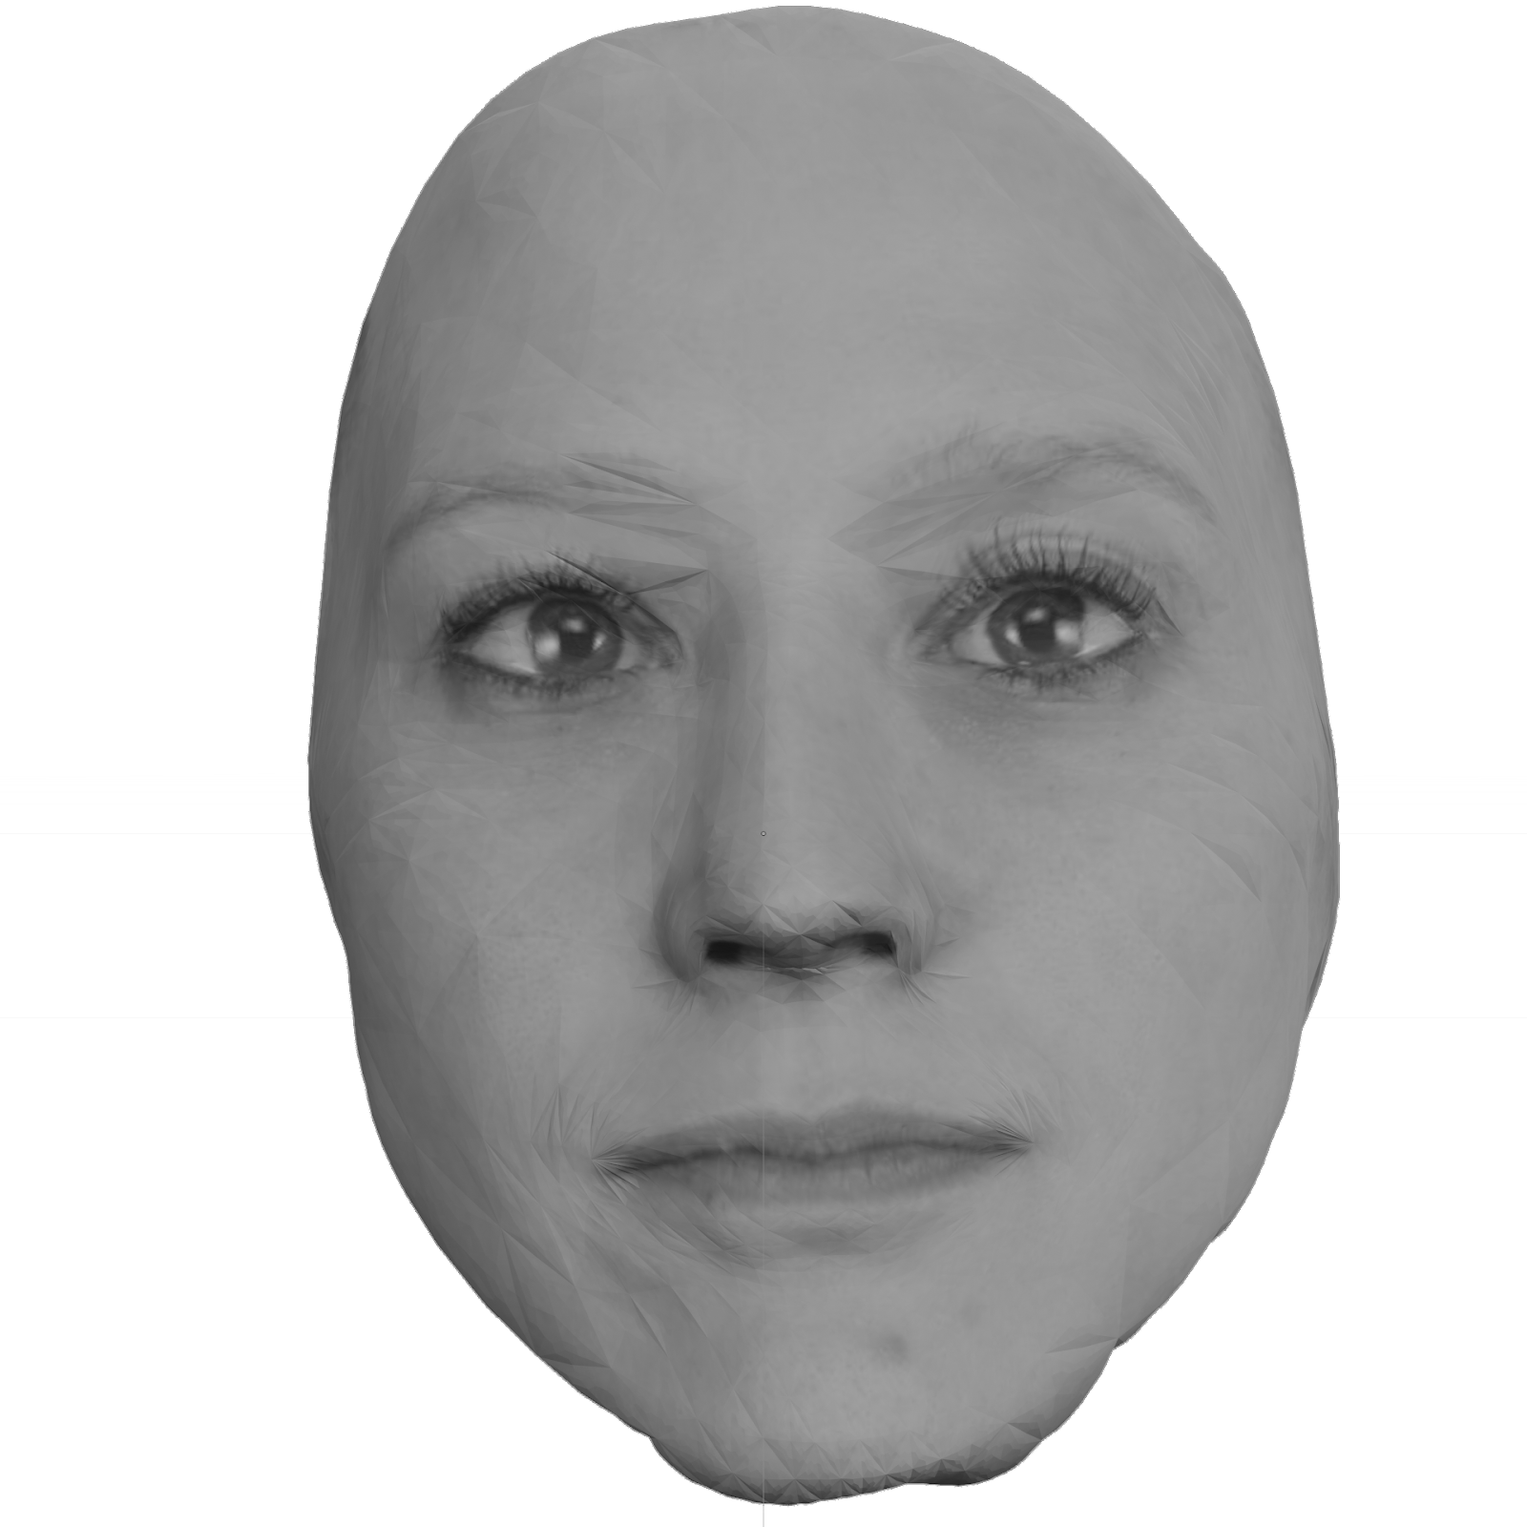
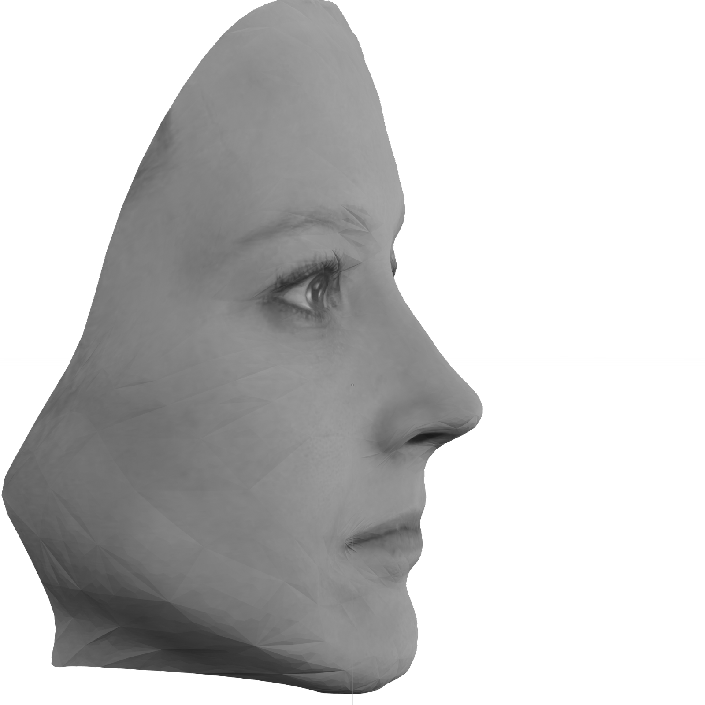

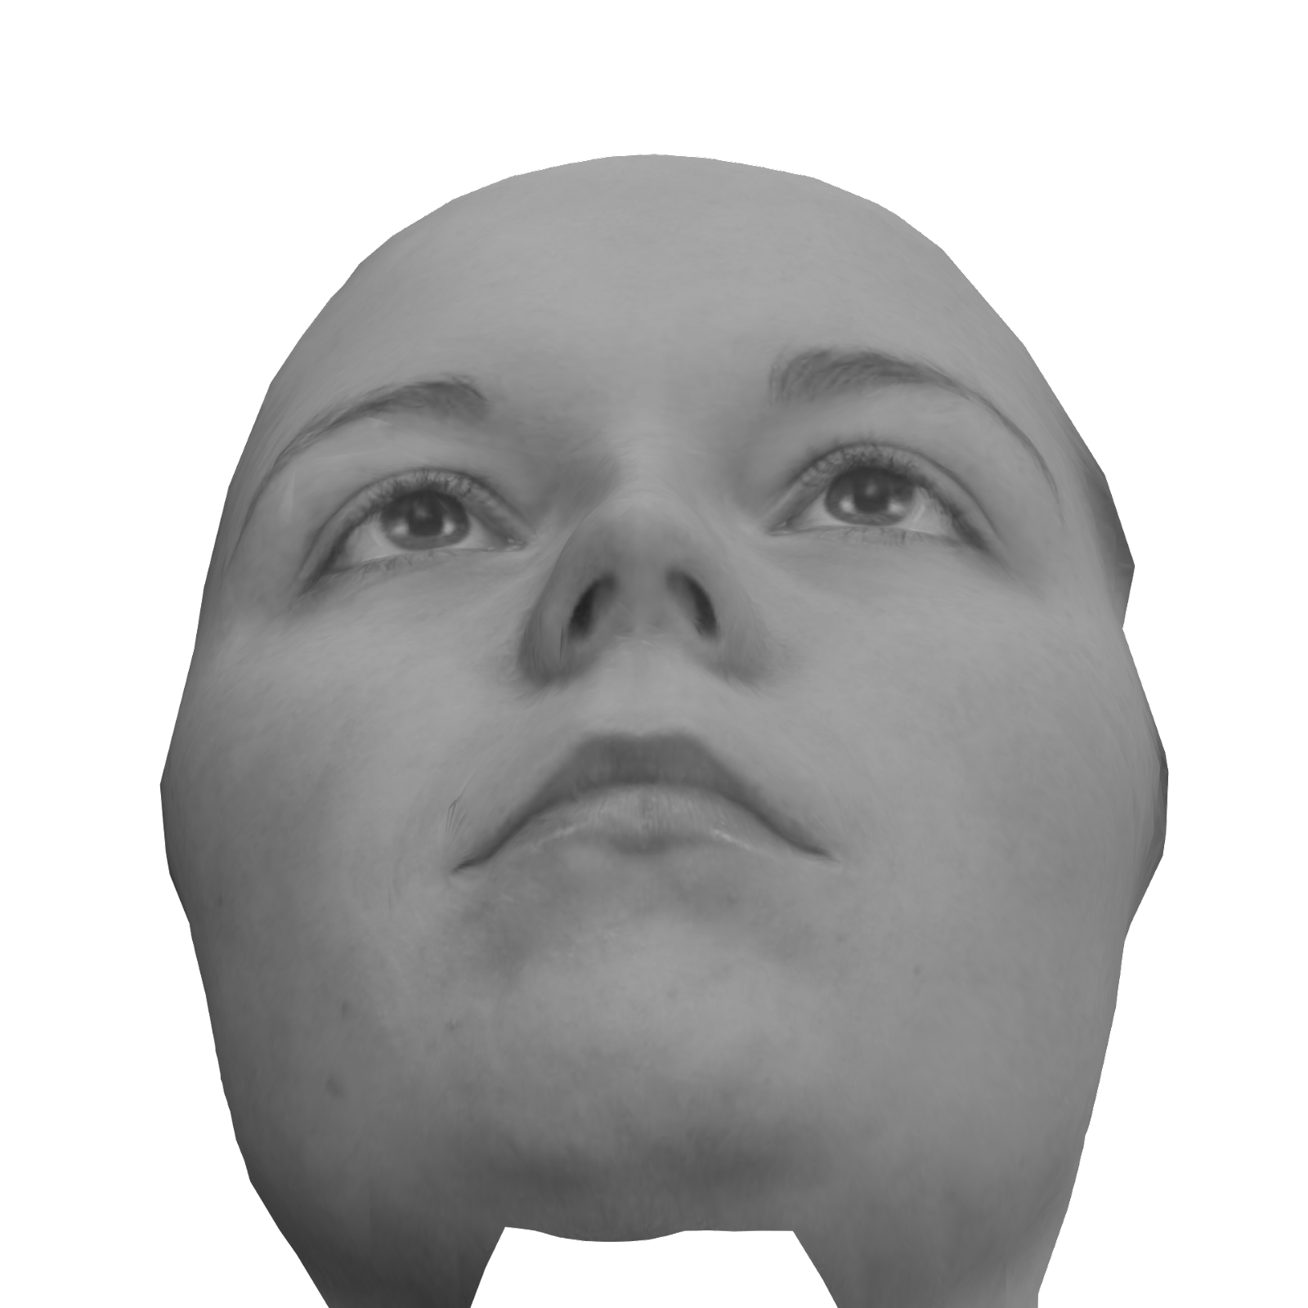
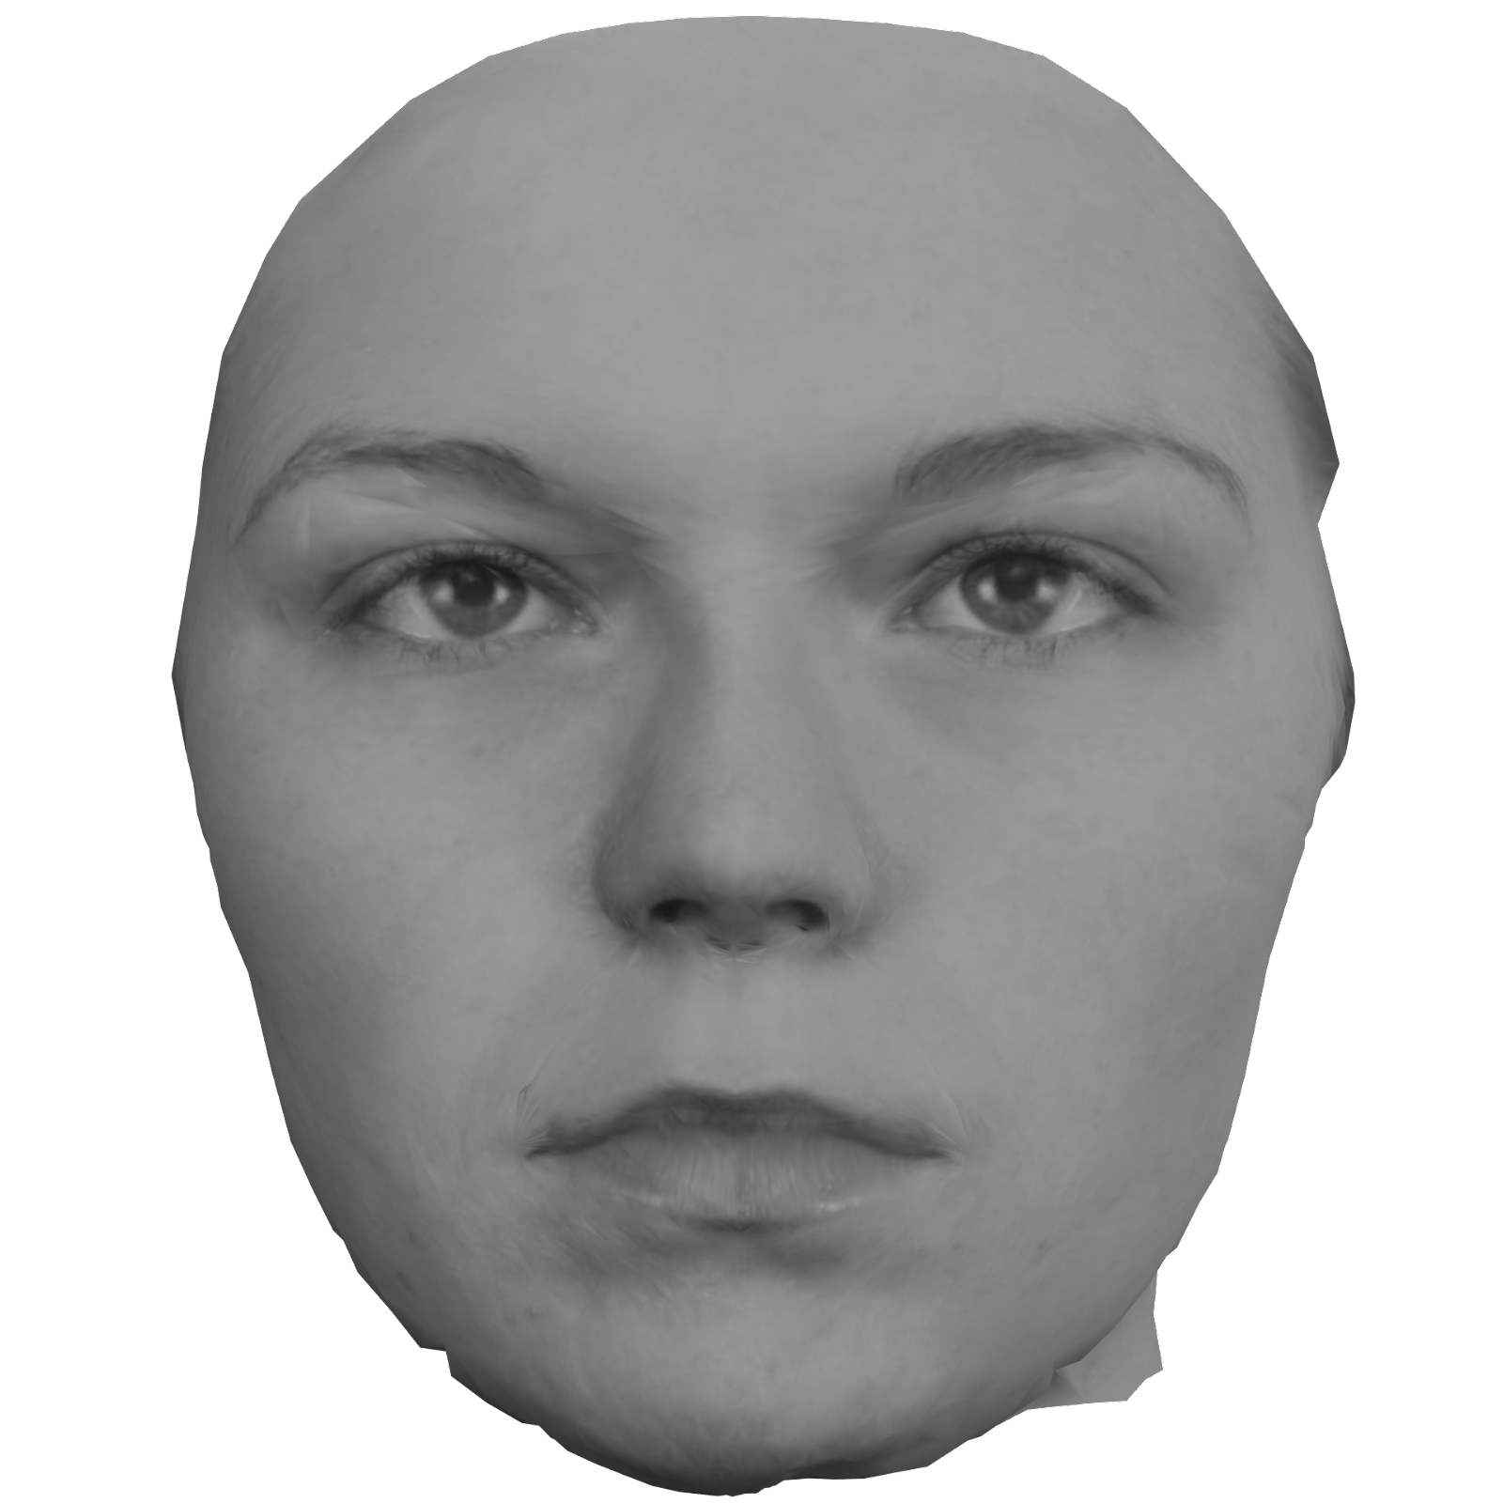
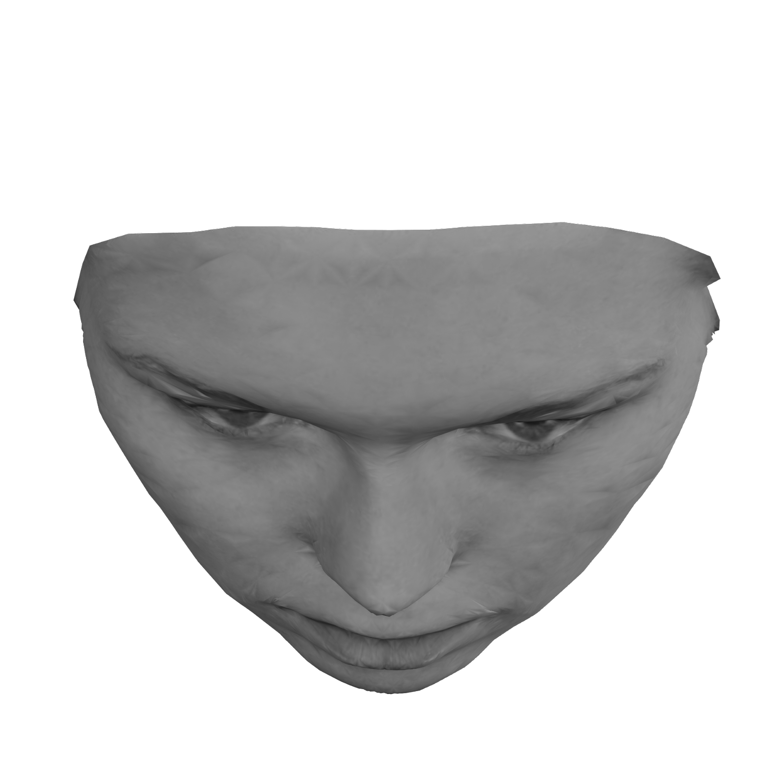
Face Recognition after Rotation
(Constant Size)
Roll
Yaw
Pitch
8°

Slide 19
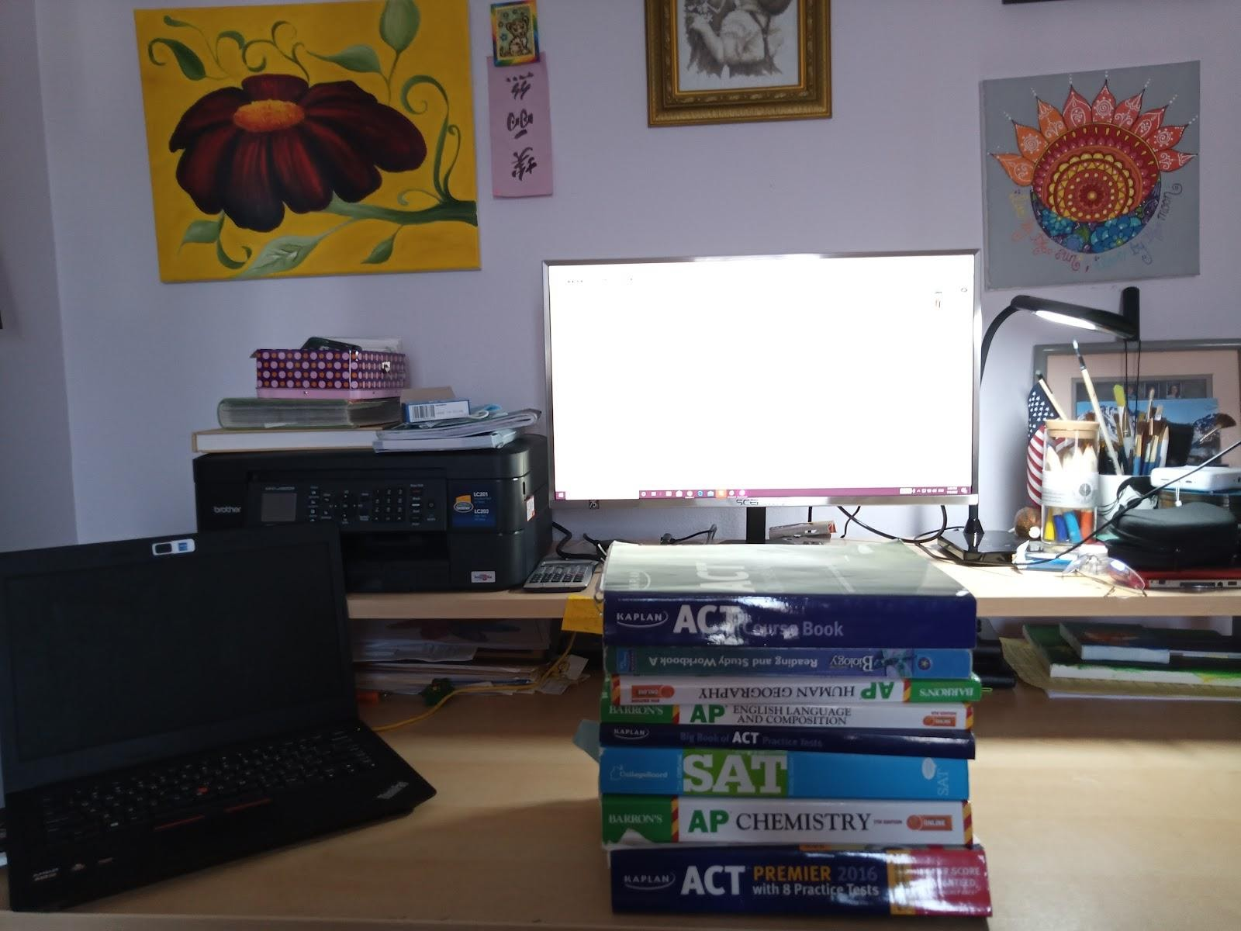
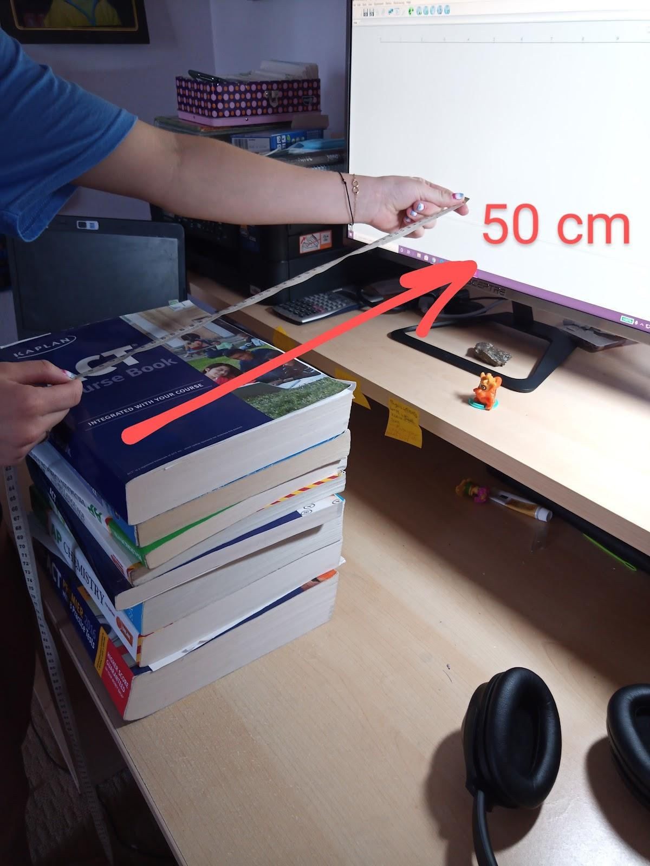
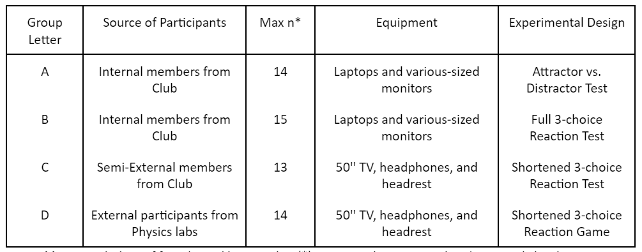
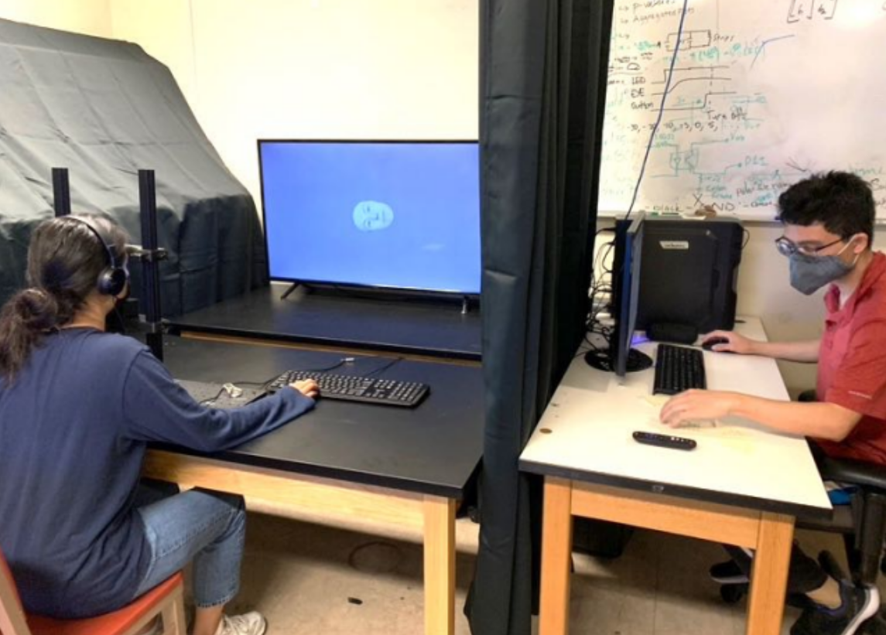

Four Groups of Data-takers
Remote
50’’ TV
140 cm
Local
Controlled

Slide 20
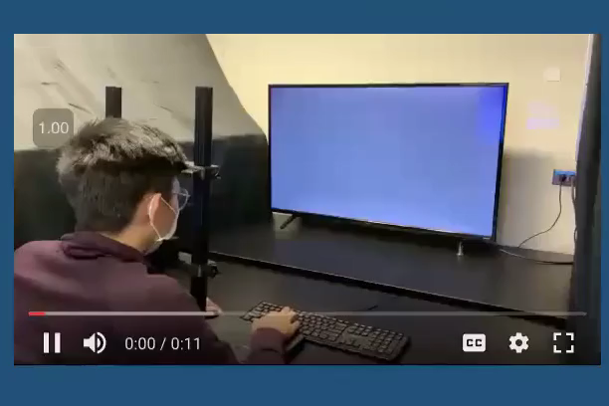

Slide 21
Cross Flash (200 ms)
Variable Pre-trial Delay
(500 - 1500 ms)
Participant Response
Post-trial Feedback
500 ms Interstimulus Period
Feedback

Slide 22
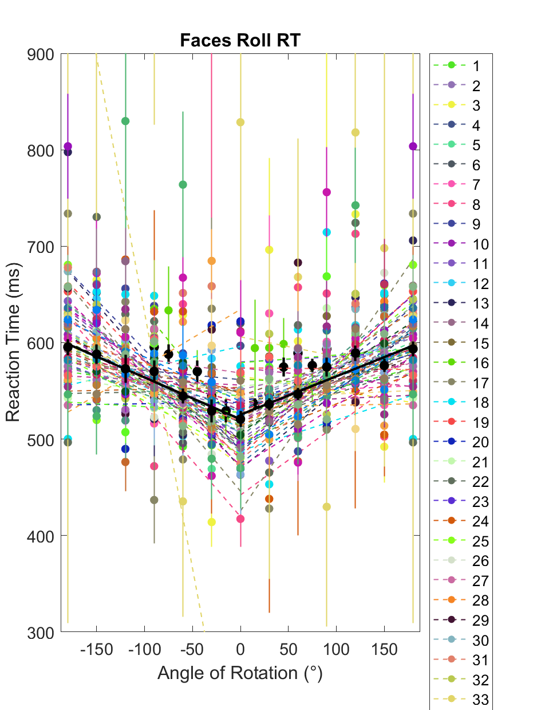
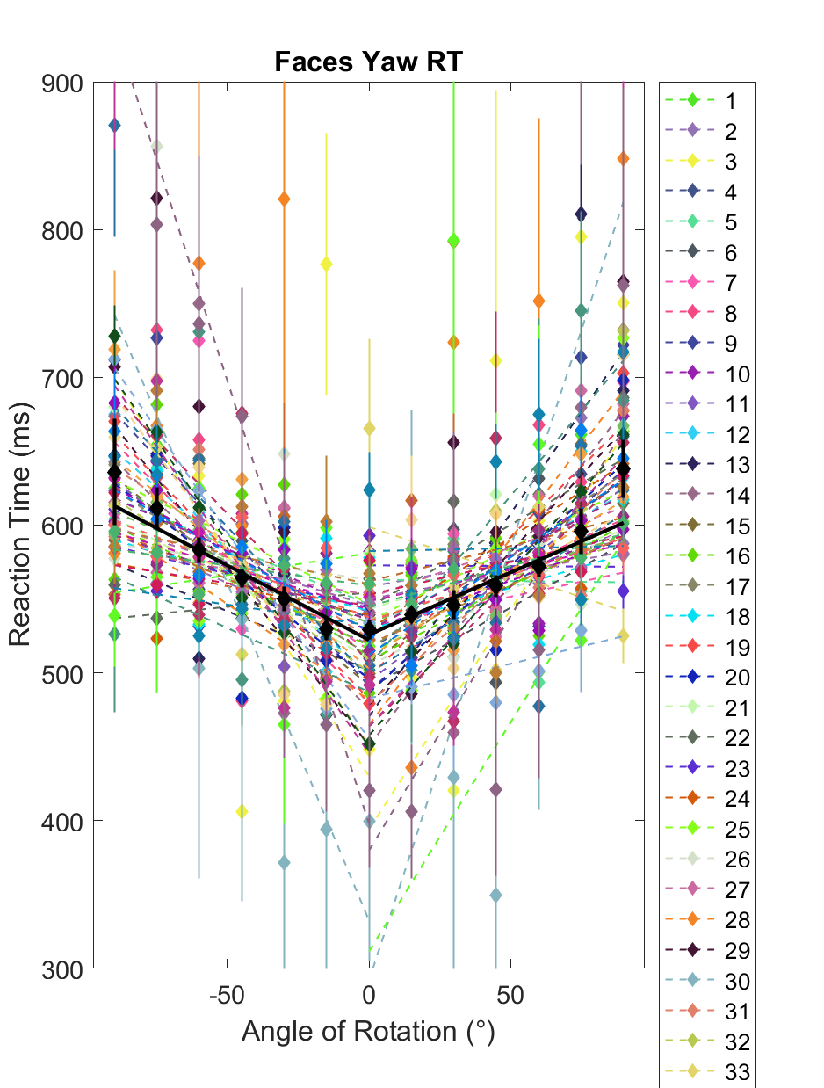
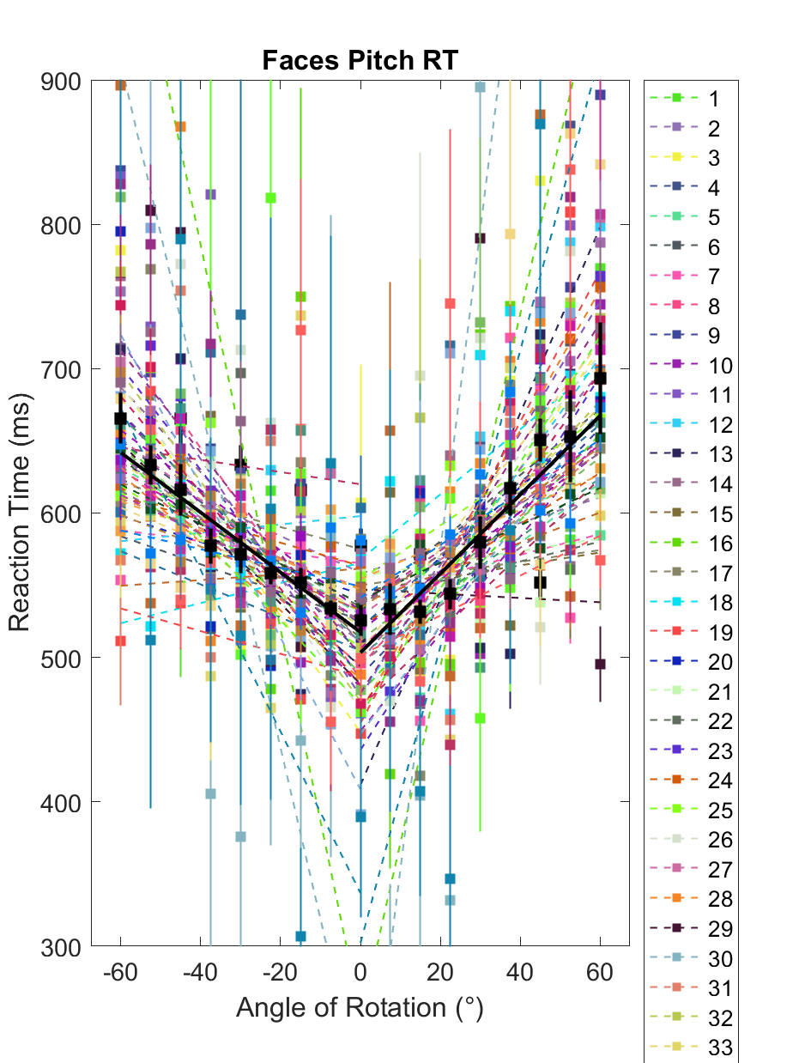
Results (n = 55)

Slide 23
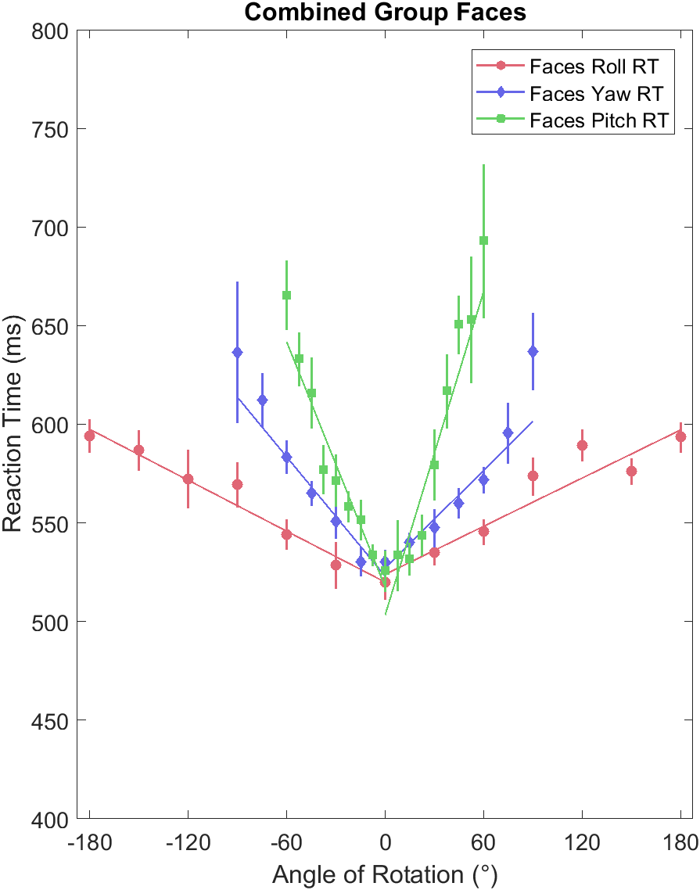
Reduced Chi Squares:
Pitch
Left: 0.85
Right: 2.14
Yaw
Left: 0.81
Right: 1.02
Roll
Left: 0.25
Right: 1.68
Pitch
Yaw
Roll

Slide 24
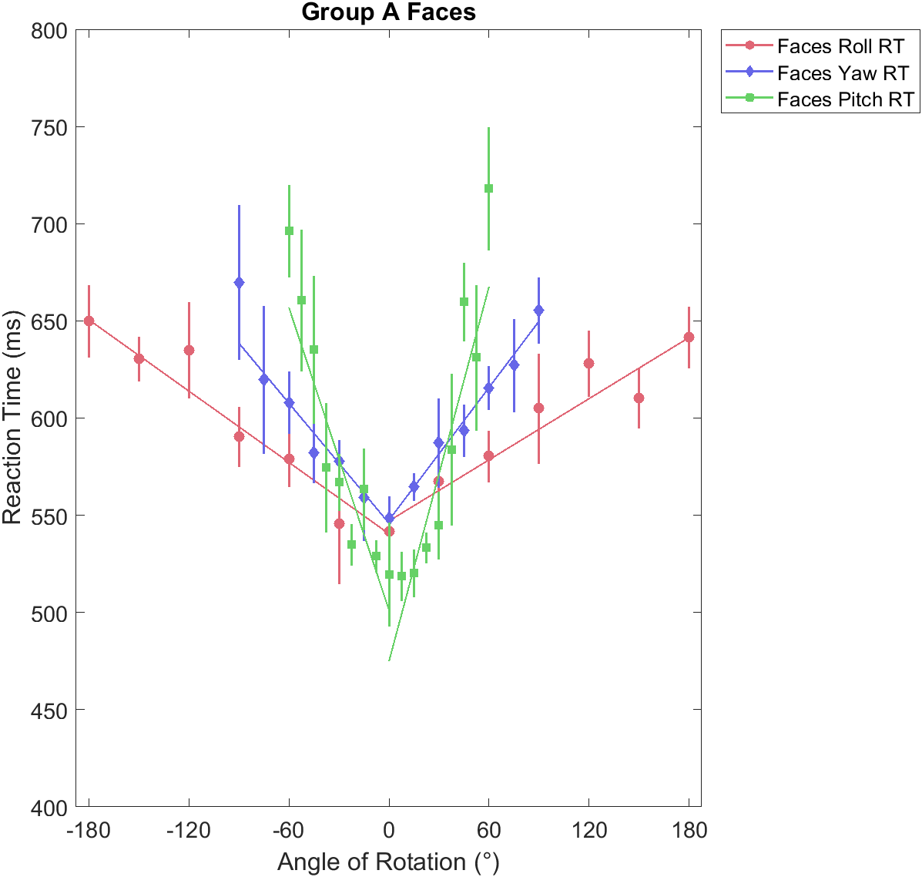
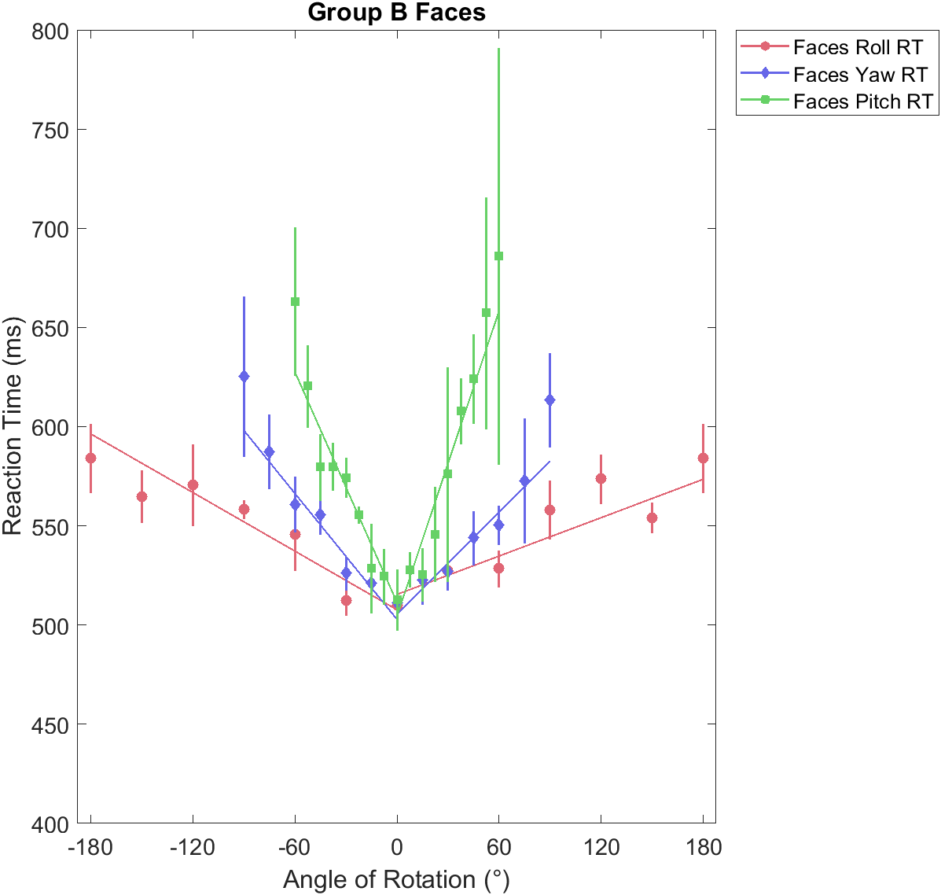
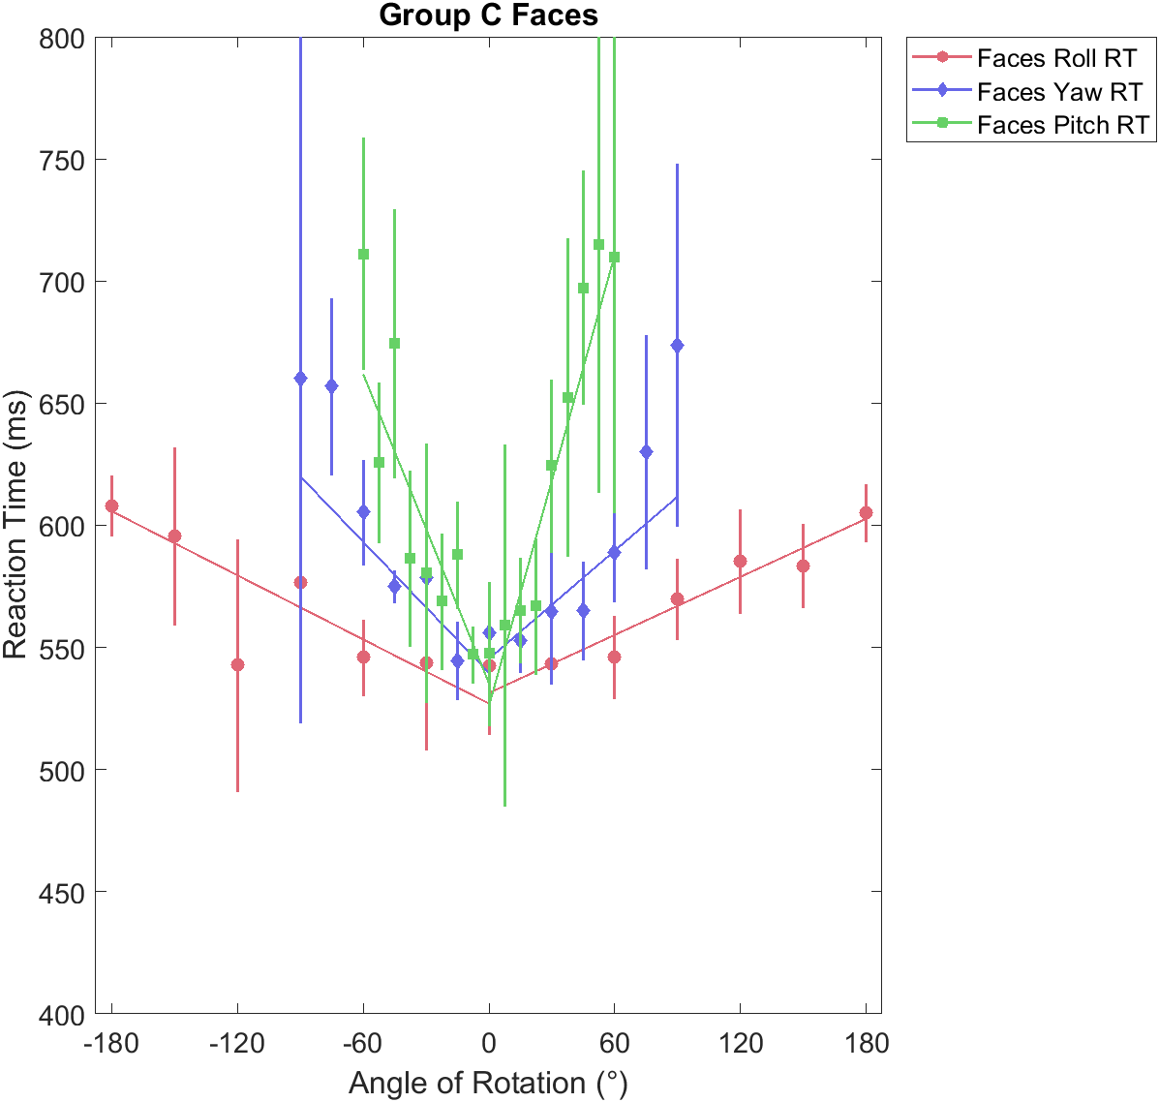
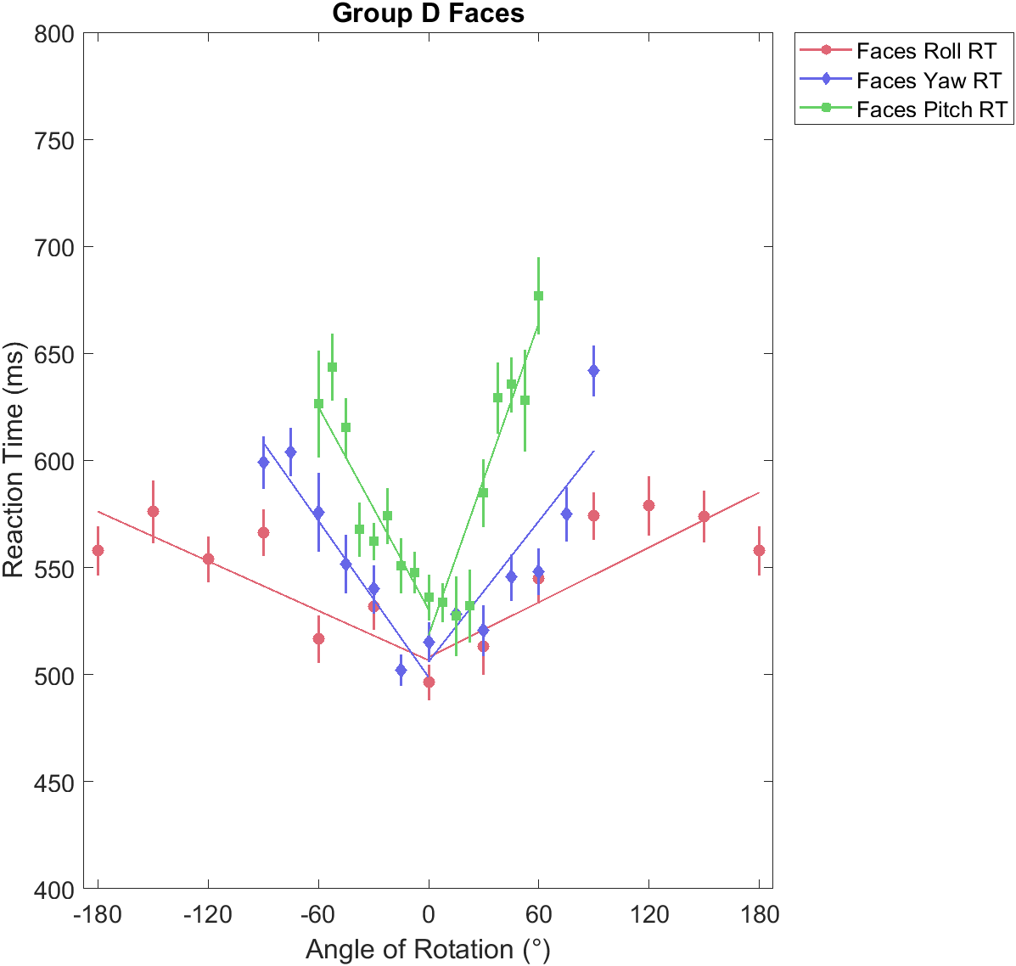
Consistency Across Four Groups

Slide 25
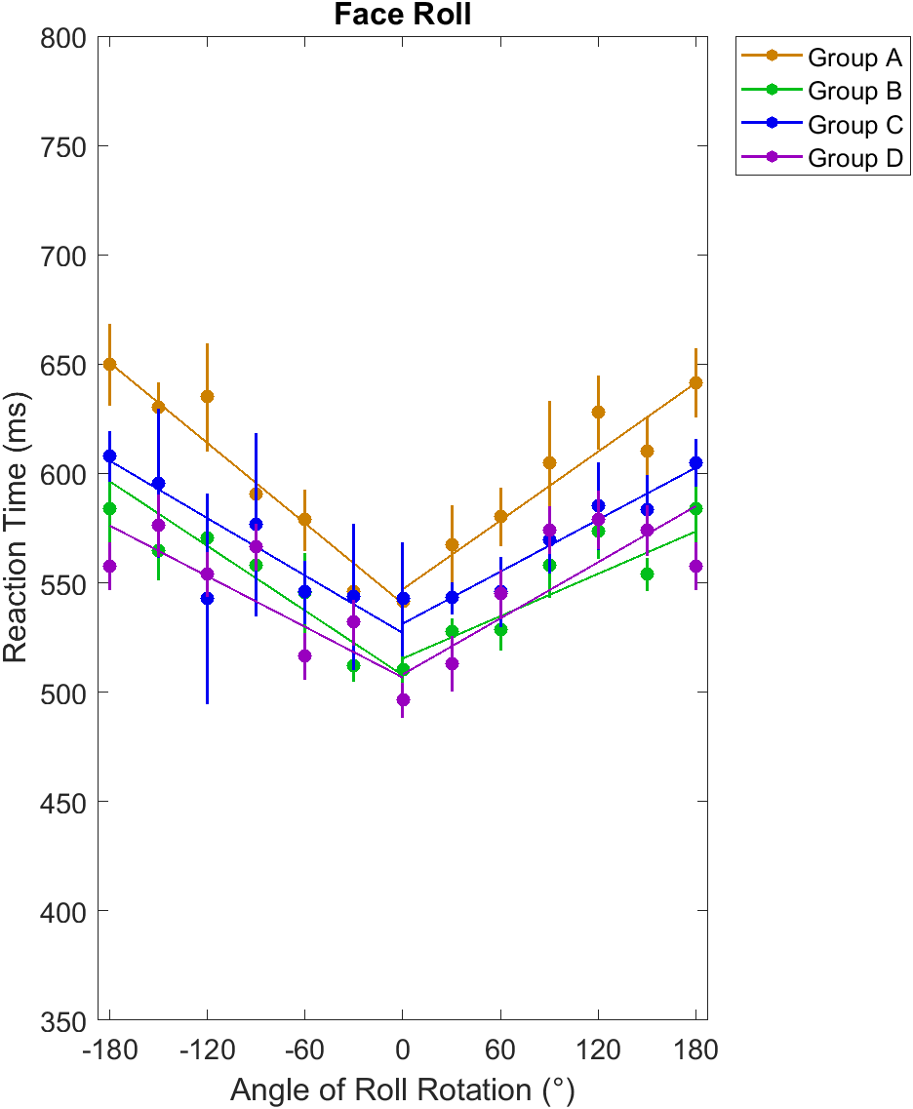
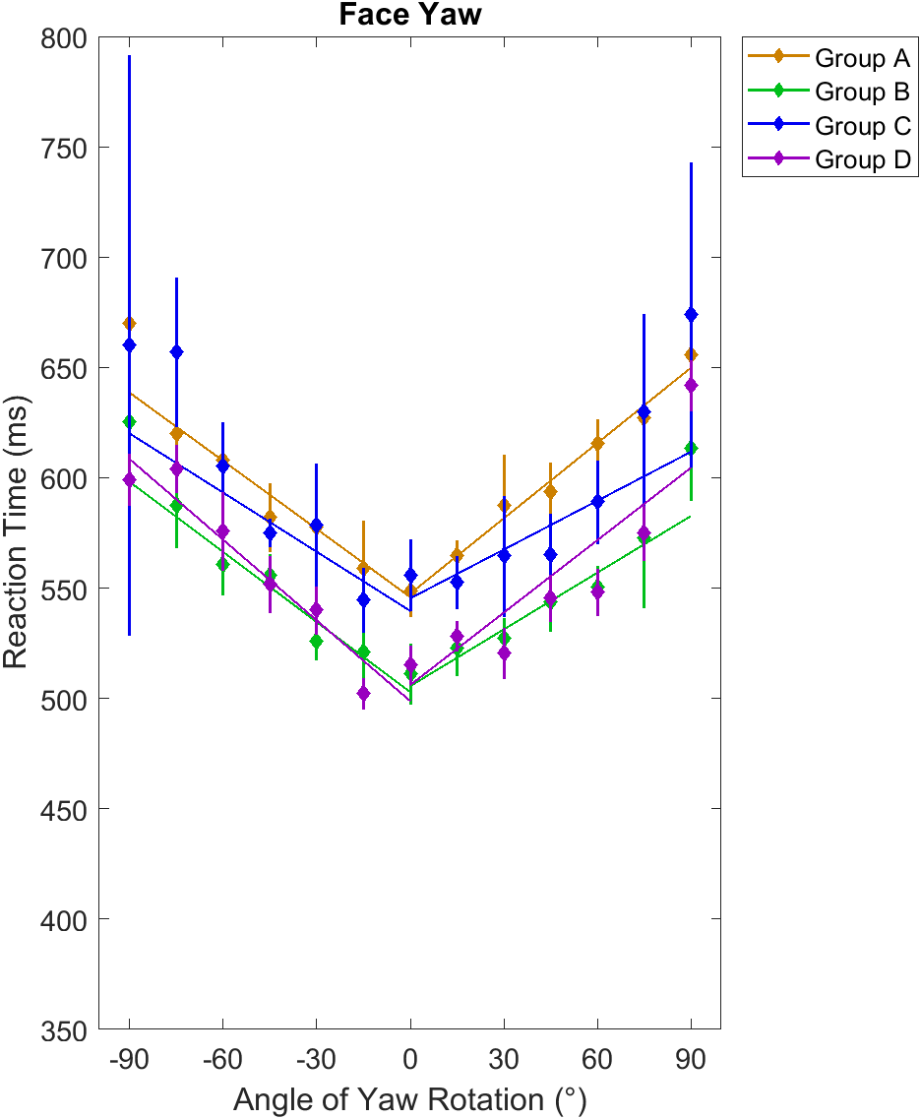
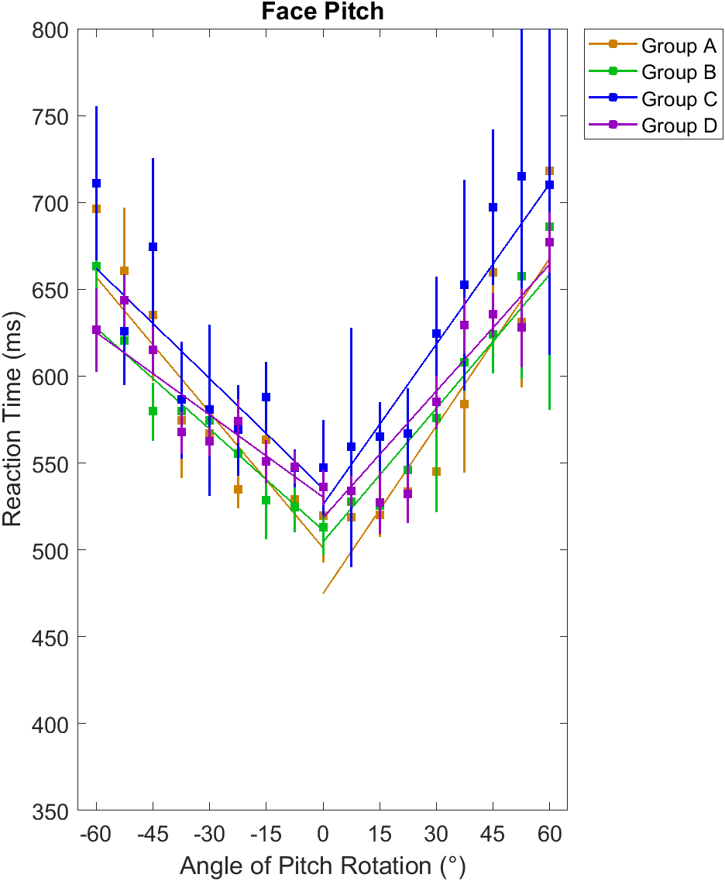
Group A
Group C
Group B
Group D

Slide 26
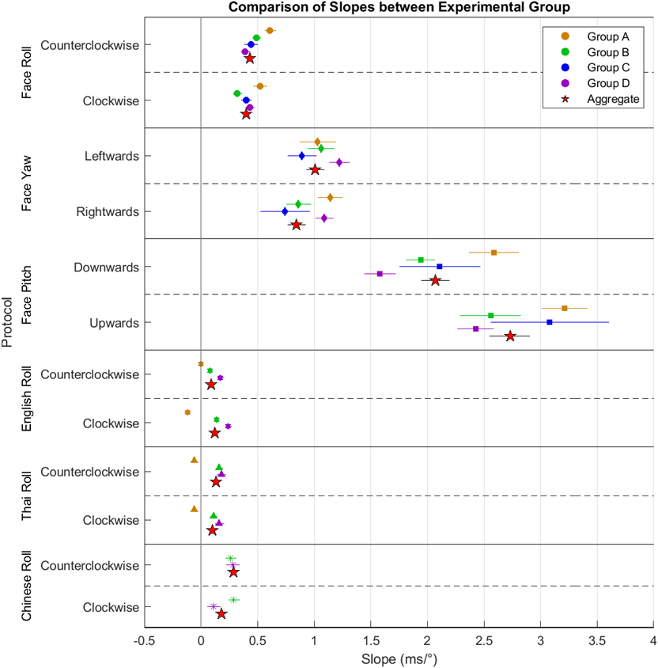

Slide 27
Conclusions

Slide 31

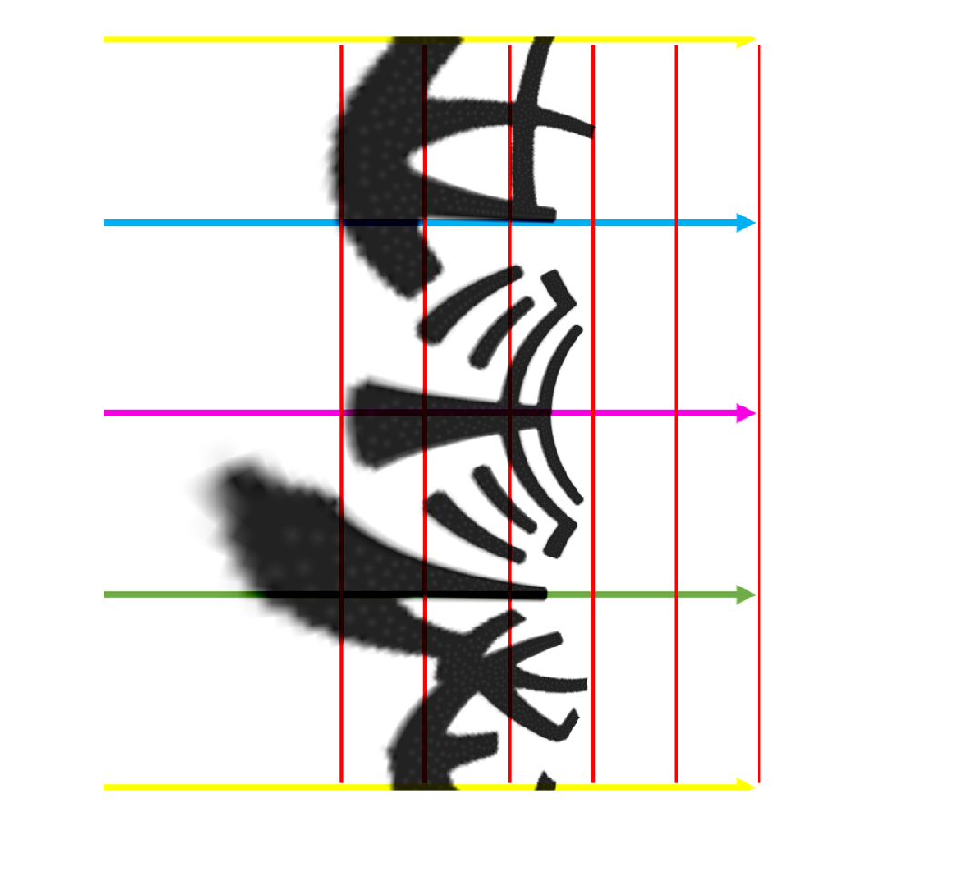
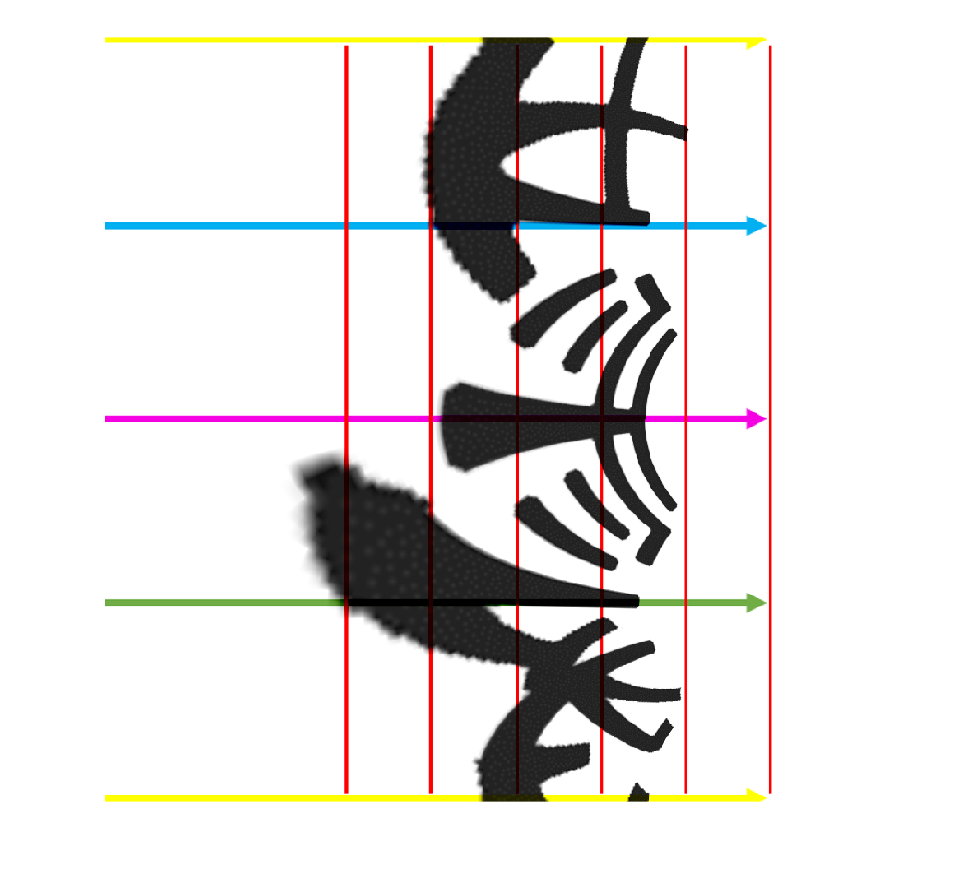
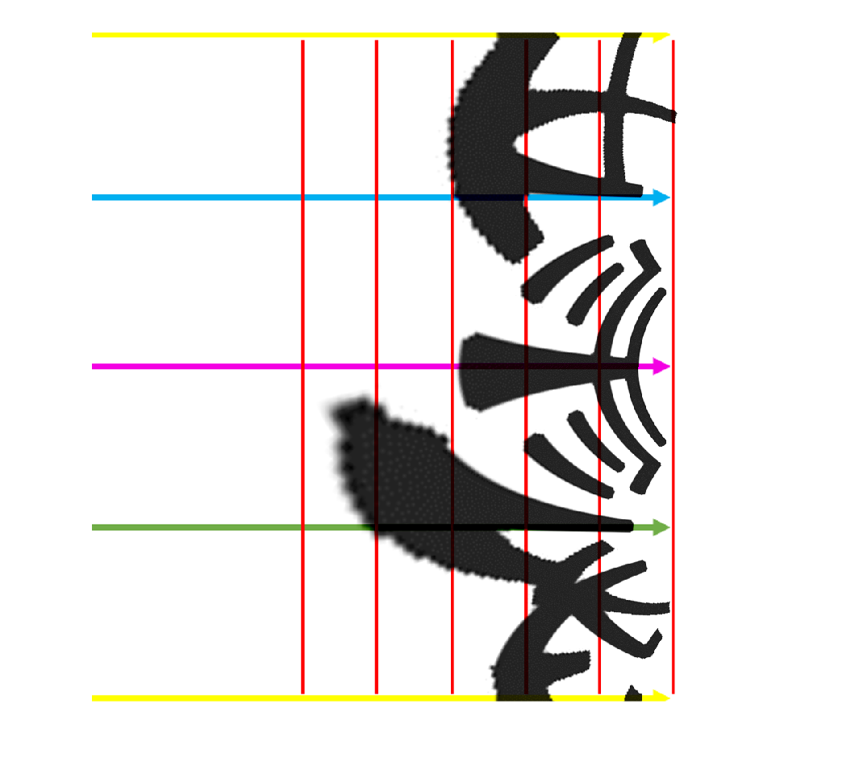

Slide 32
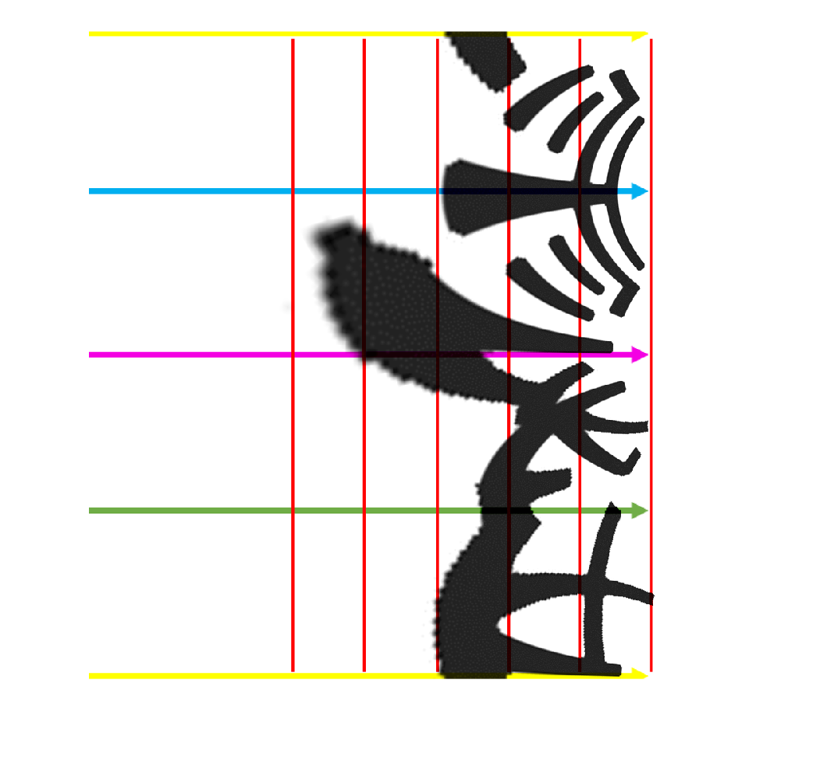
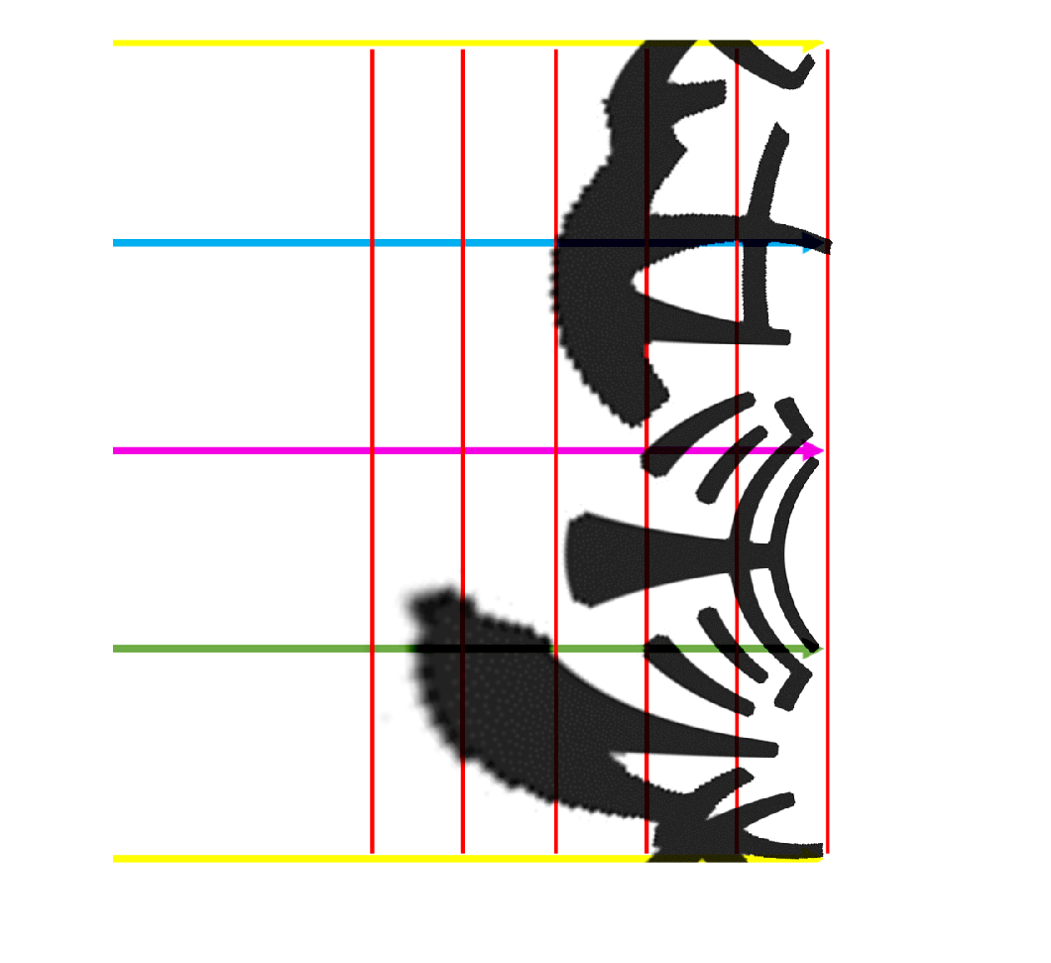

Slide 33

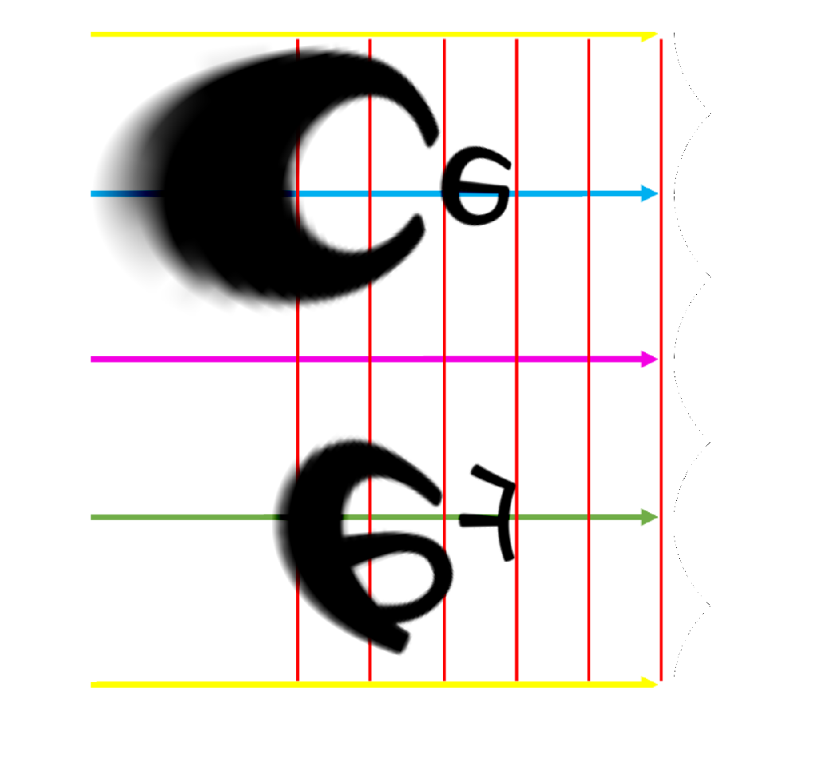
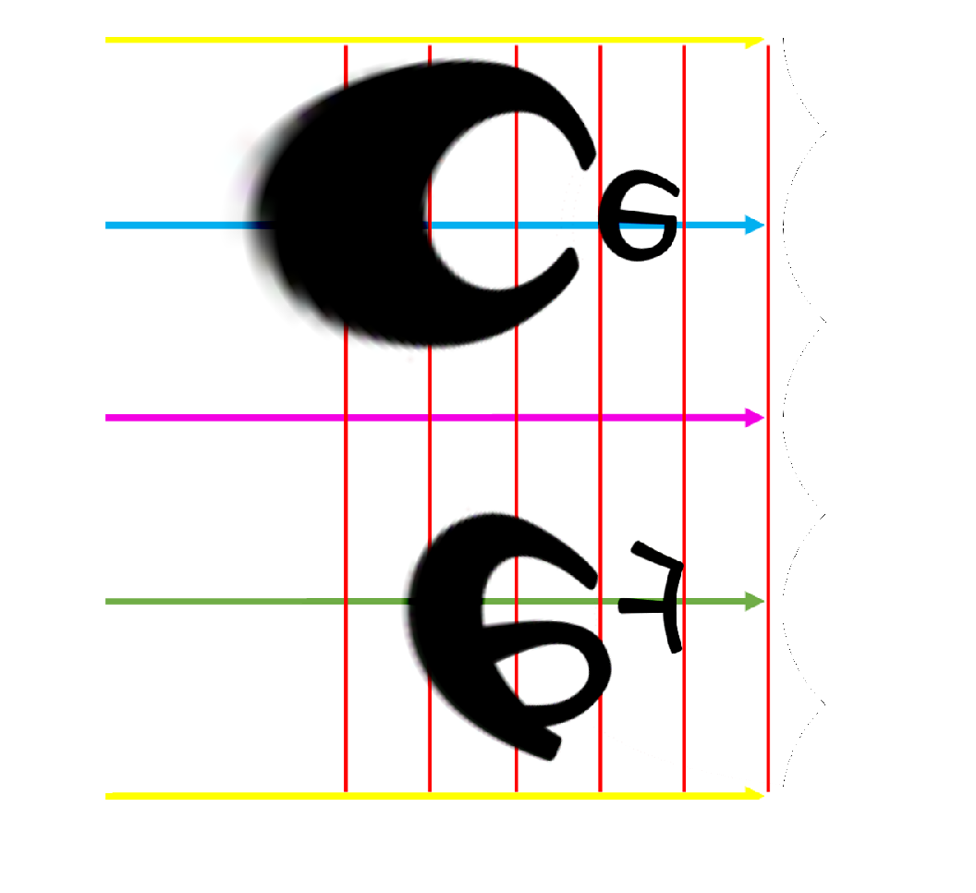
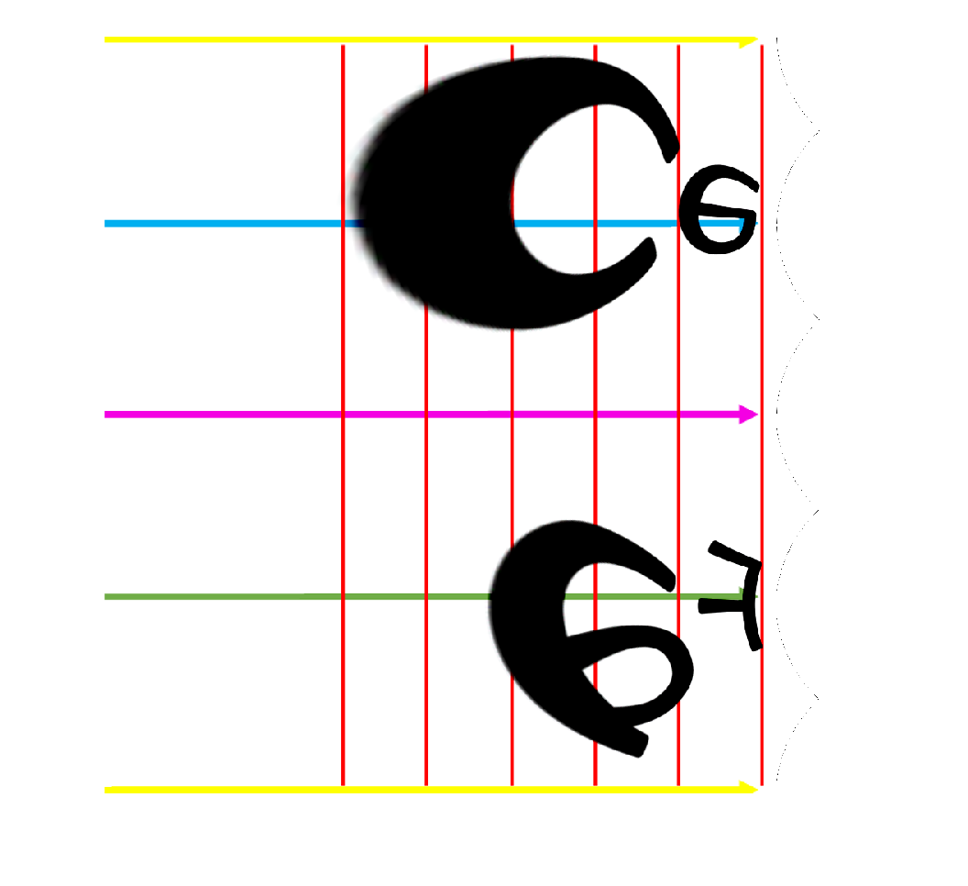

Slide 34
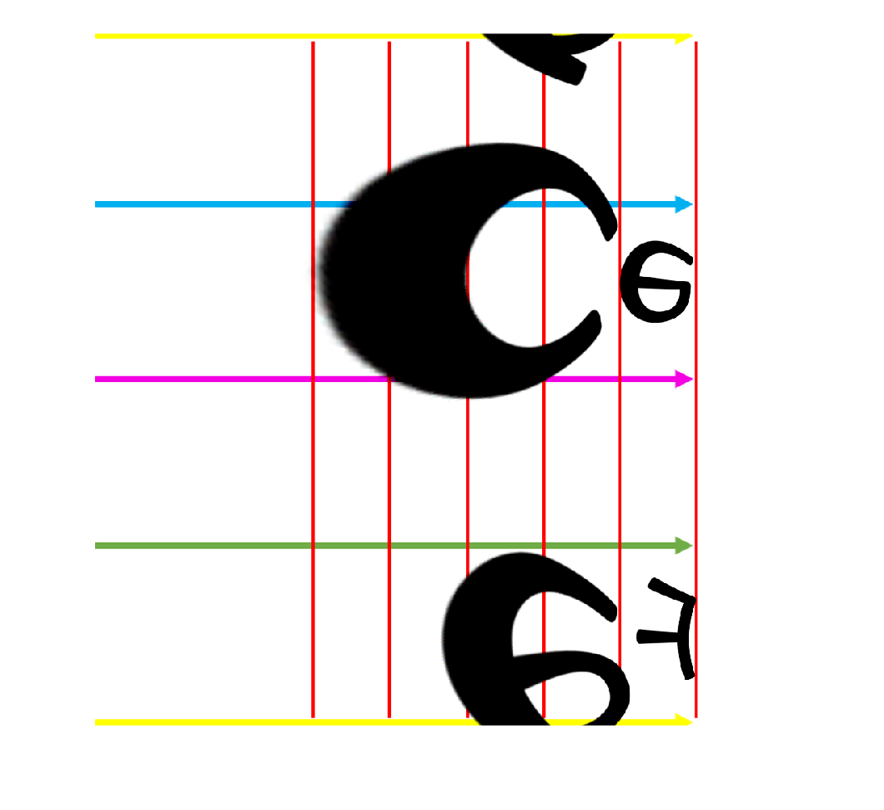
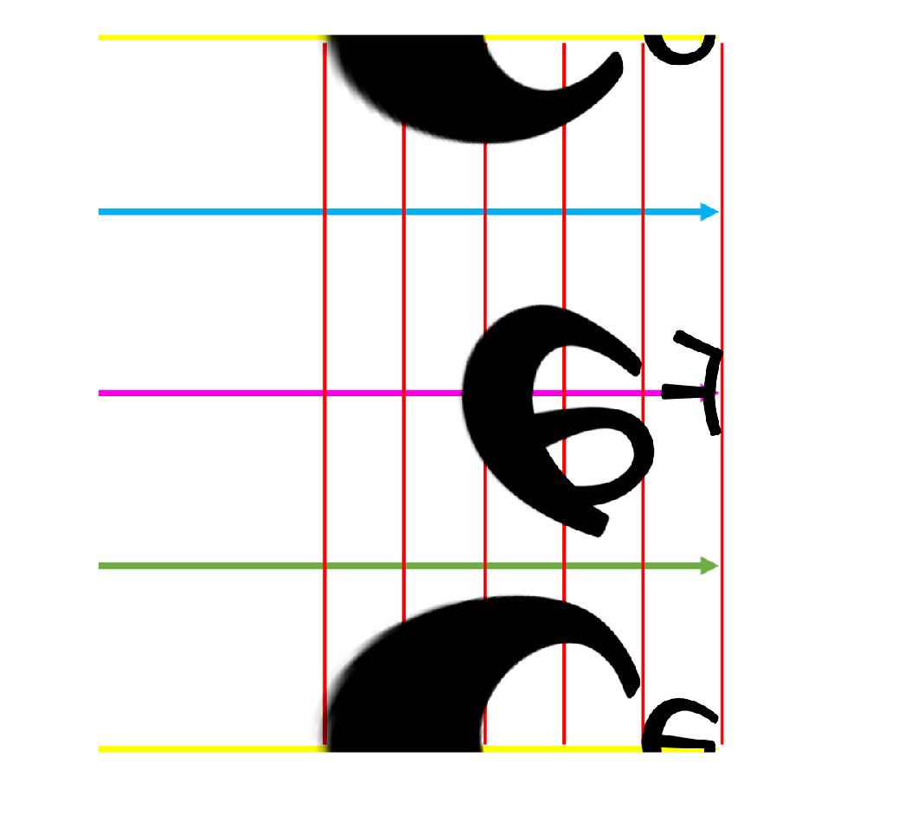

Slide 35
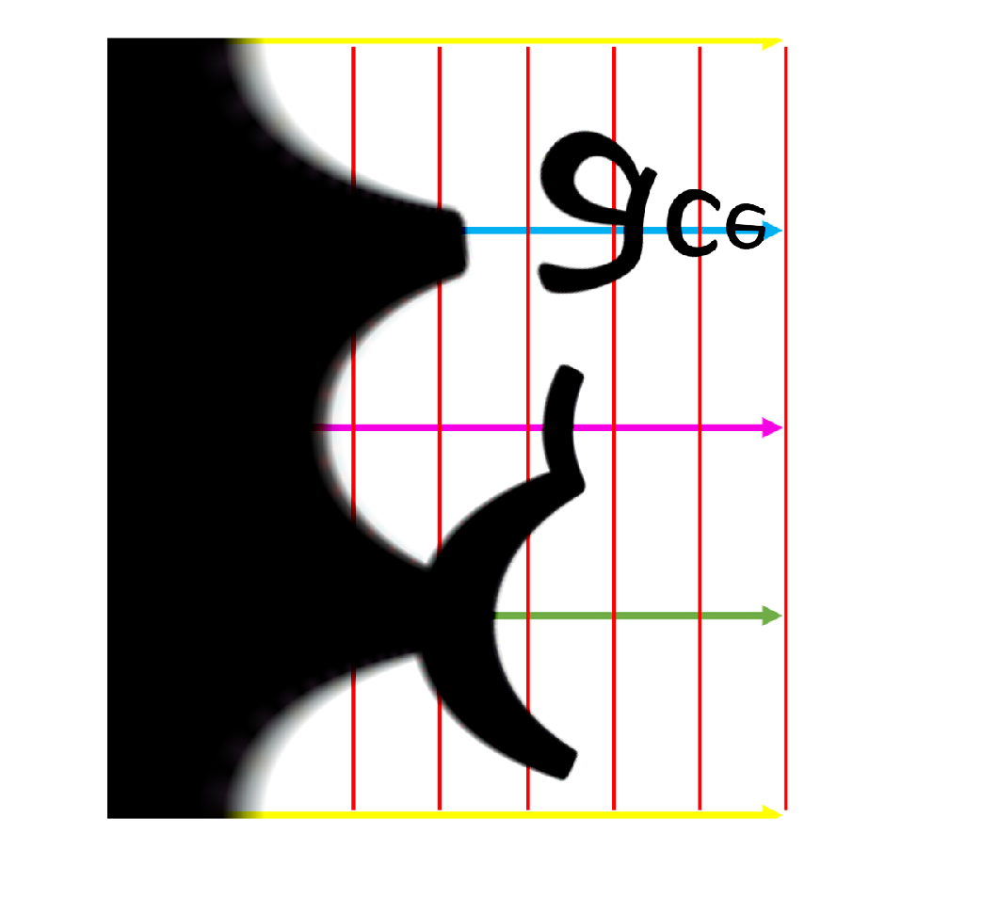



Slide 36







Slide 37







Slide 38







Slide 39







Slide 40




Slide 41







